Slide 1
10/20/14
Homework: Agenda Questions. Textbook Reading due Friday.
Objective: We will be able to calculate the heat added during phase changes.
Catalyst: Are the following endothermic or exothermic:
A. Making popsicles
B. Lighting a match
C. Cooking an Egg
D. Candle wax melting
E. Burning sugar
10/20 Week 8 Catalyst Sheet 41
10/20 Week 8 Agenda 42
10/20 Textbook Reading: Week 8 43
10/20 NOTES: Heat in Phase changes 44
10/20 Heating Curve Skills Worksheet 45

Slide 2
Announcements
Tutoring this week: Monday and Tuesday after school in 324.
Unit test: WEDNESDAY!
Lab Reports were due Friday!
Textbook Reading was due Friday!

Slide 3
Agenda
Catalyst
Announcements
HW Review
Demo
Notes/Practice
Skills Practice (if time)

Slide 4
HW Review
10. Exothermic: c, d, e, h, k
Endothermic: a, b, f, g, I, j
11. In an exothermic reaction heat is lost by the system. Picture of anything with heat moving OUT of the system.
12. 120 J. Endothermic (+Q)
13. -301 J. Exothermic (-Q)

Slide 5
Boiling Water Demo
Complete the top part of your notes sheet for today during the demo.
What happened to the energy?

Slide 6
Heating Curve
Work with a neighbor to answer the questions related to the heating curve for water.
Think carefully about #7 and #8
We will review the answers in 6 minutes.

Slide 7
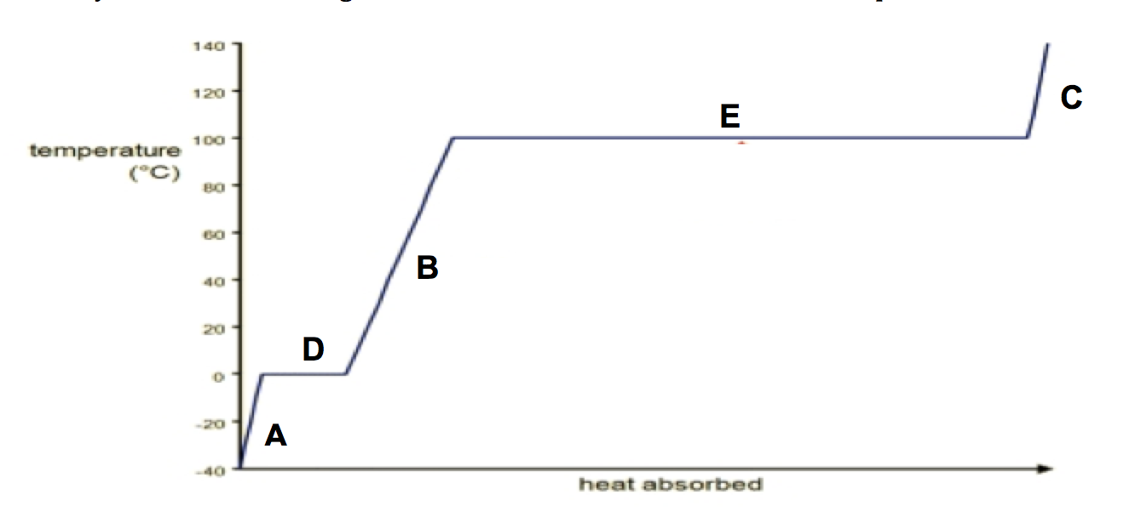
Heating Curve of Water
Boiling (Evaporation) →
← Condensing
gas
Melting →
← Freezing
liquid
solid

Slide 8
**Key Point:
Latent Heat: Heat energy released/absorbed by a system that does not change the temperature of the system.
Most often occurs in phase changes.

Slide 9
Q=CmΔT
Why doesn’t this equation work during parts D and E on the graph?

Slide 10
Types of Latent Heat
Heat of Vaporization (ΔH_{v})= The heat needed to change state liquid → gas.
*Note: If a substance changes phase from a gas to a liquid ΔH_{v} is negative.

Slide 11
Types of Latent Heat
Heat of Fusion (ΔH_{f})= The amount of heat needed to change state solid → liquid.
*Note: If a substance changes phase from a liquid to a solid ΔH_{f} is negative.

Slide 12
EQUATIONS:
Vaporization:
Q=mH_{v}
Fusion:
Q= mH_{f}
_{***m=mass}

Slide 13
Heating Curve of Water
Q = m•ΔH_{V} →
← Q =m•-ΔH_{V}
Q = m•c•ΔT
Boiling (Evaporation) →
← Condensing
gas
Q = m•ΔH_{f} →
← Q =m•-ΔH_{f}
Melting →
← Freezing
liquid
Q = m•c•ΔT
solid
Q = m•c•ΔT

Slide 14
Practice
Use the information provided on your worksheet to answer practice questions 1-6. We will review the answers before you leave.

Slide 15
Heating Curve Skills
Remember the strategies we discussed on Friday:
Read & annotate questions
Annotate tables/graphs
Answer questions
Read passage if required
You will have 6 minutes to complete this skills passage (this is very similar to your unit test skills passage!!)

