Slide 1
10/6/14
Homework: None!
Objective: We will be able to define energy and differentiate between potential and kinetic energy.
Catalyst: How do you define “energy”? How does energy relate to chemistry?
10/6 Catalyst Chart: Week 6 29
10/6 Week 6 Agenda 30
10/6 Bill Nye/NOTES: Energy 31

Slide 2
Announcements
Tutoring: Tuesday and Thursday after school.
Progress Reports are pulled TODAY.

Slide 3
Agenda
Catalyst
Announcements
Notebook Quiz
Bill Nye: Energy
Energy Discussion/Notes

Slide 4
Notebook Quiz!
You need a half sheet of paper (you can share with a neighbor)
Put your name, date and period in the top right corner.

Slide 5
What is on page 20 of your notebook?
What page is your Week 5 agenda on?
Turn to page 22 and flip to the back of the paper, What four things could a physical change involve?
Turn to page 25, what word is next to 4.a.?
Turn to page 28, what is question #15? (not the answer, just the question)

Slide 6
Bill Nye Video Instructions
Watch video clip and answer the first 10 questions DURING the video
Answer questions 11-12 when prompted by instructor
Answer questions 13-24 after discussion
Take notes on back
ALL INSTRUCTIONS MUST BE FOLLOWED FOR STAMPS TODAY

Slide 7
After Video Questions
Answer questions 11-12 on your own, then share out with your partner.

Slide 8
Notes: Energy
31

Slide 9
Energy
Energy:
The capacity to do work, anything that can carry out an action
Unit: Joules (J)

Slide 10
Energy
Law of Conservation of Energy:
Energy cannot be created or destroyed, just changed into a new form

Slide 12
Potential & Kinetic Energy
Potential Energy:
Kinetic Energy:
Stored energy. Has the
POTENTIAL to become another form of energy. (gravitational, elastic, chemical)
Energy of motion (heat, light sound, mechanical, electrical)

Slide 14
PE & KE in Chemistry:
Potential: Stored energy in bonds (if bond is broken can carry out an action)
Kinetic: energy of movement (atoms/molecules always moving)

Slide 15
Problems 13-22
Answer problems 13-22 with your partner
We will go over answers as a class once done

Slide 16
Potential or Kinetic?
Kinetic

Slide 17
Potential or Kinetic?
Kinetic

Slide 18
Potential or Kinetic?
Potential

Slide 19
Potential or Kinetic?
Potential

Slide 20
Potential or Kinetic?
Kinetic

Slide 21
Potential or Kinetic?
Potential

Slide 22
Potential or Kinetic?
Kinetic

Slide 23
Potential or Kinetic?
Kinetic

Slide 24
Potential or Kinetic?
Potential

Slide 25
Potential or Kinetic?
Potential

Slide 26
Potential vs. Kinetic
Name your OWN example of potential and kinetic energy on your worksheet

Slide 28
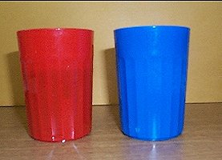
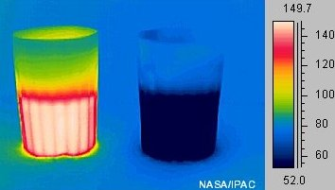
Energy & Heat
The more energy the molecules in an object have, the faster they move. The faster molecules move, the more heat an object has.

Slide 29
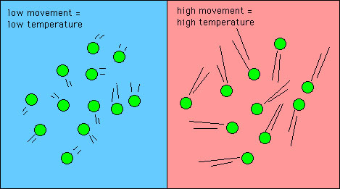

Slide 30
Heat
Heat: total energy of molecular motion in a substance
Depends on the speed of the particles, the number of particles, and type of particles.
Molecules are always moving, so ALL SUBSTANCES HAVE HEAT!!

Slide 31
Demo
What happens when the food coloring is added? Why?
In which beaker are the molecules moving faster? Why?

