Slide 1
10/7/14
Catalyst: If you were to spend a whole class period walking and just taking 1 inch steps, would you get very far? If everyone in the school did the same thing would we walk very far TOTAL? Explain your answers.
Homework: Agenda Problems.
Objective: We will be able to explain the difference between heat, thermal energy and temperature.
10/7 Heat, Thermal Energy and Temperature 32

Slide 2
Announcements
Tutoring: TODAY and Thursday after school.

Slide 3
Agenda
Catalyst
Demo: Heat vs. Temperature
Notes on Heat Vs. Temperature

Slide 4
Predict & Explain
Read the prompt at the top of today’s handout and silently record your response.

Slide 5
Demo
For the next 5 minutes, record your data for Beaker A and Beaker B.
Be sure to record all temperatures and observations of the flow of the food coloring.

Slide 6
Pair-Share
Answer questions 1-3 with your elbow partner.

Slide 7
Thermal Energy
Definition:
The total amount of kinetic energy associated with the random motion of molecules.

Slide 8
Thermal Energy
Symbol: H
Units: Joules (J)

Slide 9
Heat
Definition:
Energy that transfers from one object to another due to temperature differences.

Slide 10
Heat
Symbol: Q, ΔH
Units: Joules (J)

Slide 11
Temperature
A measure of the average amount of thermal energy particles possess.

Slide 12
Temperature
Symbol: T
***NOTE: ΔT = change in temp
Units: Celsius (°C) Kelvin (K)
Fahrenheit (°F)

Slide 13
Temperature
Temperature is related to how fast the molecules are moving.
Example: In the demo, the food coloring was moving much faster in Beaker A, and Beaker A reached the highest temperature.

Slide 14
Temperature
Include this in your notes:
Temperature determines which direction heat energy will flow.
Do you think heat flow from hot objects to cold objects or from cold objects to hot objects? How do you know?

Slide 15
Heat
Heat always flows Hot → Cold

Slide 16
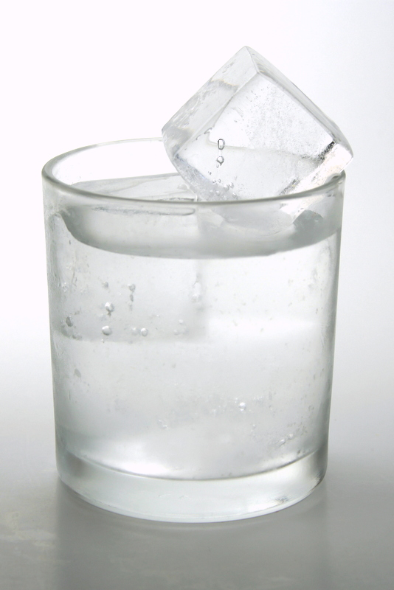
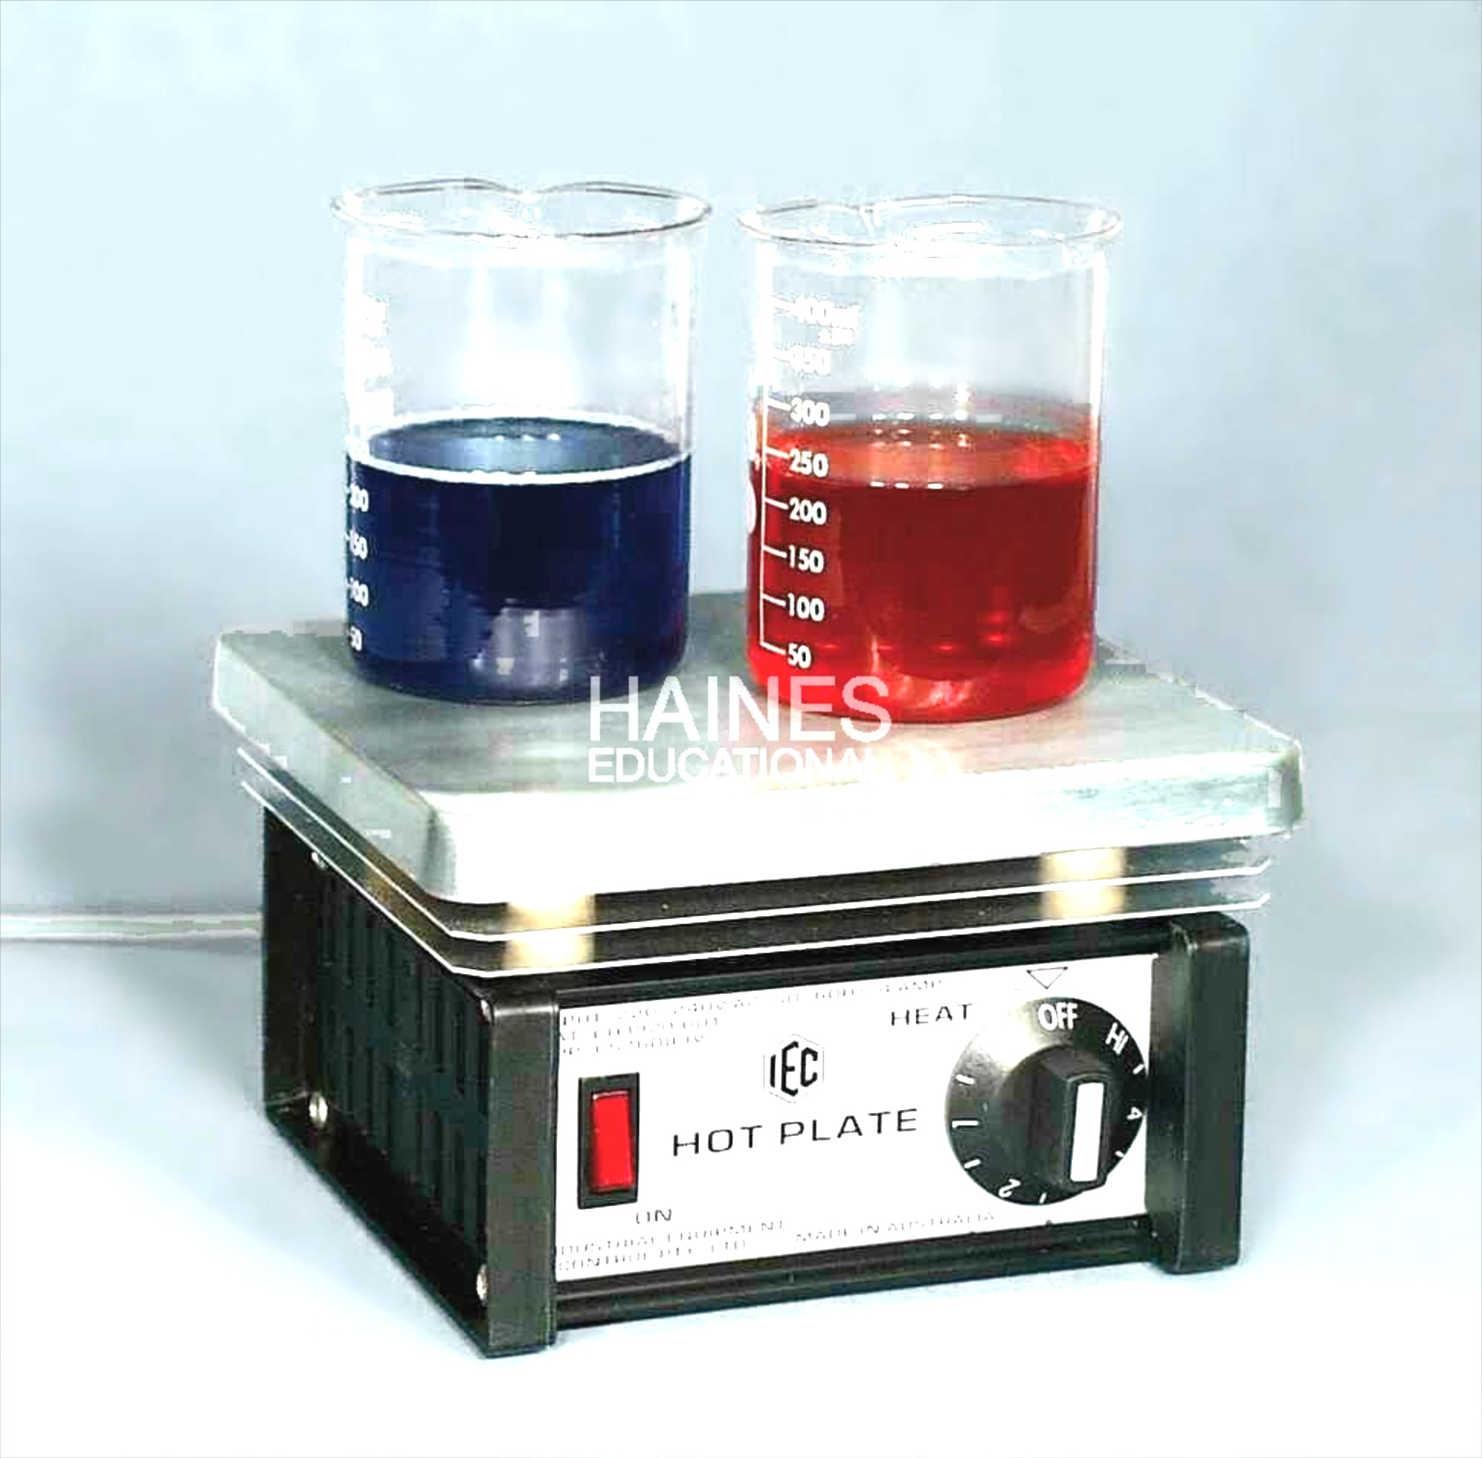
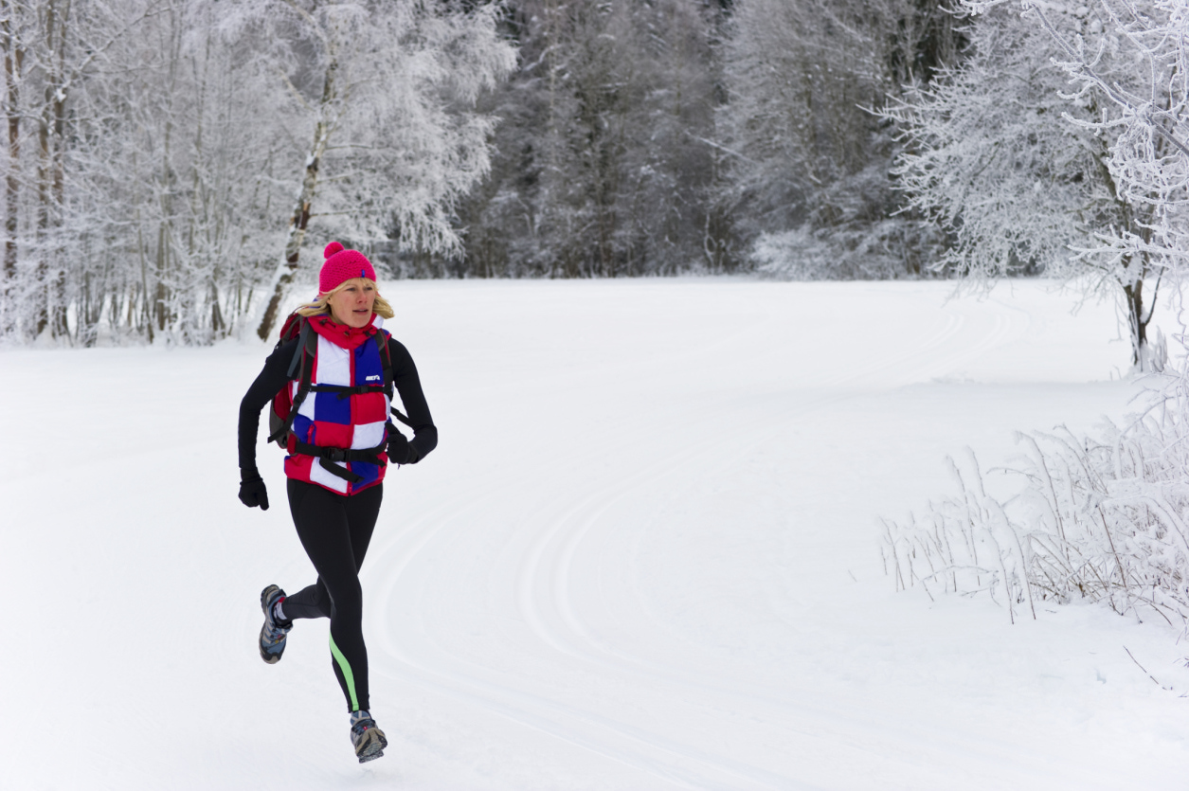
Examples

Slide 17
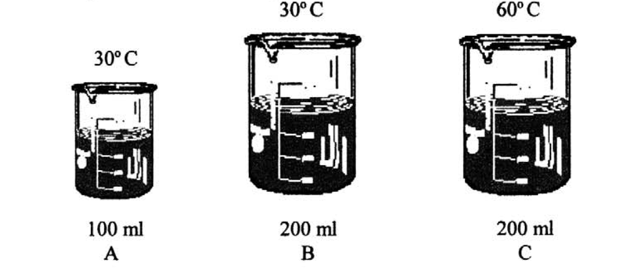
Practice Questions

Slide 18
Fill in the Table

Slide 19
Discuss with a Partner
If you had a metal cube and a plastic cube at the same temperature, which would have more energy? Why?

