Slide 1
11/19/14
Homework: Complete Review Objectives 5, 6 & 7. (#19-29)
Objective: We will be able to explain why atoms form ions and draw Bohr models to illustrate this process.
Standard: IOD 504
Catalyst Answer Choices:
Decreases only
B. Remains the same
C. Increases only
D. increases, then decreases
***READ THIS!!!!***
Announcements:
Tutoring this week: Thursday after school in 324.
Unit 3 Test Friday!
Notebook Check will be next Monday (weeks 9-12)
11/19 CLASSWORK: Ions 73

Slide 2
Agenda
Catalyst/Announcements
HW Review
Review POGIL
Notes: Ions
Practice: Ions

Slide 3
HW Review
10. 62.7 amu
11. 237.98 amu
14.
18.
C C E M E C C M
Iron-80 | ⁸⁰₂₆Fe | 26 | 26 | 26 | 54 | 80

Slide 4
POGIL Review
Take out your POGIL Ions packet from yesterday and be ready to answer questions if Miss Miller calls on you.

Slide 5
Classwork
Take out your worksheet for today. Answer this question at the top:
In your own words what is an ion and how is it different from a neutral atom?

Slide 6
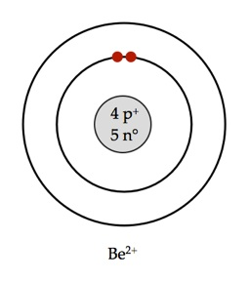
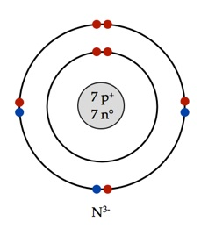
Ions
An ion is an atom with a positive or negative charge.
Occur when there is an unequal number of protons and electrons.

Slide 7
Ions
Ions are created by the loss or gain of electrons.

Slide 8
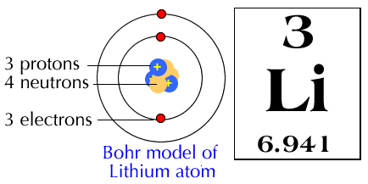
Discuss
Lithium atoms like to form lithium ions with a +1 charge. Why can’t you add 1 proton to a lithium atom to form the lithium ion?

Slide 9
**Key Point
Why do neutral atoms form ions?
An atom is most stable when it has a full outer shell of valence electrons. Atoms will gain or lose electrons until they are stable and have a full outer shell.

Slide 10
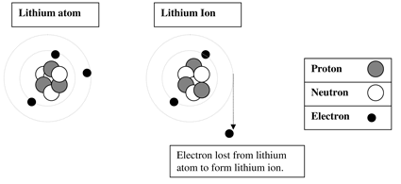
Notes
Why do neutral atoms form ions?

Slide 11
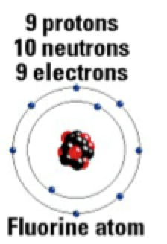
Read This
Atoms will form an ion based on the least amount of energy to fill an outer shell.
What are fluorine’s options for having a full outer shell?
Which do you think would take the least energy?

Slide 12
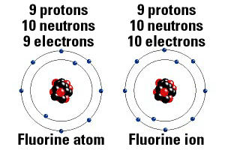
Read This
It takes less energy for lithium to lose one electron compared to the energy required to gain 7 electrons.

Slide 13
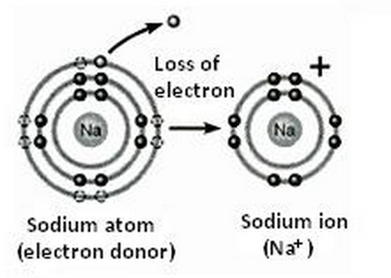
Sodium Ion
If the sodium ion loses one electron, what charge will the sodium ion have? Why?

Slide 14
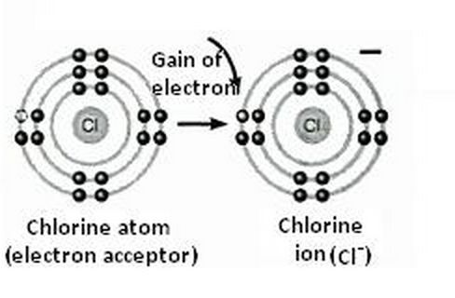
Chlorine Ion
If the chlorine ion gains one electron, what charge will the sodium ion have? Why?

Slide 15
Practice
An atom that gains 2 electrons will have a _____ charge because _________________.
An atom that loses 2 electrons will have a _____ charge because _________________.
-2
You add 2 negative charges
+2
You remove 2 negative charges

