Slide 1
12/15/14
Homework: Finish Review, start studying!
Objective: We will be able to explain the trend in electronegativity on the PT
Standard: IOD 503
(Answer TUESDAY!!!)
F. 5.0 N.
G. 7.0 N.
H. 9.0 N.
J. 11.0 N.
***READ THIS!!!!***
Announcements:
Tutoring: TODAY and Tuesday after school.
Test Wednesday!
Notebook check: Thursday!
12/15 Trends: Electronegativity 89
12/15 Catalyst Chart: Week 16 90

Slide 2
Agenda
Catalyst/Announcements
Review Atomic Radius/Ionization Energy
Trend: Electronegativity

Slide 3
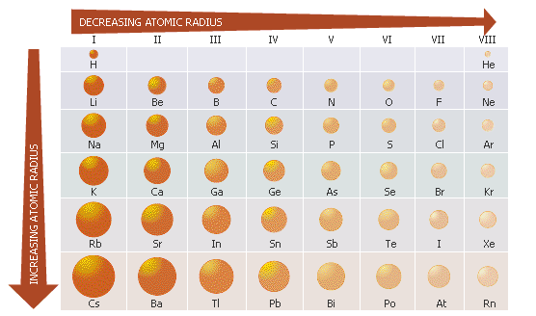
Previous Trends
What’s the trend across a period? Why?
What’s the trend down a group? Why?

Slide 4
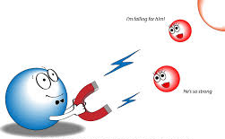
Trend # 3: Electronegativity

Slide 5
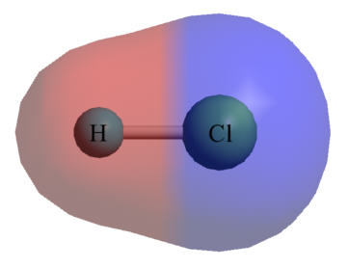
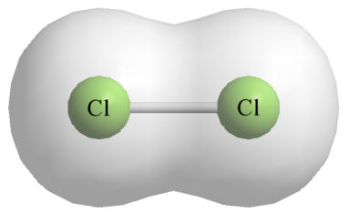
What does electronegativity mean?
An atom’s ability to attract electrons to itself in a bond.
Cl attracts electrons more
Equal sharing

Slide 6
Electronegativity
Look back at your trends sheet (p. 86), what trends do you notice in electronegativity on the periodic table?
Work with your partner to determine what happens across a period and down a group.

Slide 7
What Causes this Trend?
Remember what we learned about Coulombic attraction.
As you go across a period, what happens to the number of protons? How would this impact attraction?

Slide 8
What causes this trend?
Across a period, the Coulombic Attraction increases. More attraction means the nucleus is pulling electrons more toward itself, increasing electronegativity.

Slide 9
What Causes this Trend?
As you go across a down a group, what happens to the number of orbitals? How would this impact attraction?

Slide 10
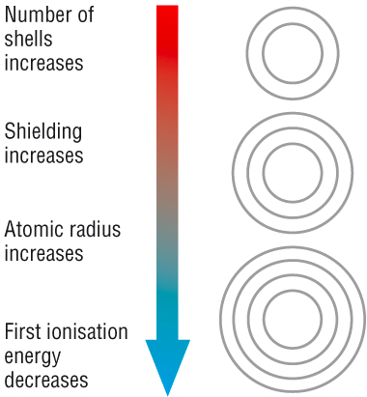
What causes this trend?
Down a group, Coulombic Attraction decreases. Nucleus doesn’t attract electrons to itself as much, so electronegativity decreases.

Slide 11
Using the Trend
The element with the largest atomic radius…
The element with the smallest atomic radius…
greatest electronegativity
least electronegativity

Slide 12
Connect Your Learning!
Think. Pair. Share. How are atomic radius, ionization energy and electronegativity related?

Slide 13
Skills Questions
Annotate the graph. What do you notice happening? What trends do you observe? (Use your PT as well!)
Use the graph of Electronegativity vs. Atomic Number to answer the skills questions that follow.
You will have 5 minutes to answer these independently.
Share your answers with your partner.
Discussion

Slide 14
Write
Use what you have learned today to answer the prompt provided in complete sentences.
Your answer should include specific data (numbers) and reference the trend.

