Slide 1
12/2/14
Homework: PT Inquiry questions checked Thursday, Agenda Qs
Objective: We will be able to differentiate between metals and nonmetals.
Standard: EMI 401
Catalyst:
A. the same altitude.
B. a higher altitude.
C. a slightly lower altitude.
D. a much lower altitude.
***READ THIS!!!!***
Announcements:
Tutoring this week: TOMORROW after school.
TOMORROW is EXPLORE/PLAN/ACT testing day! (Only see periods 4-7)
12/2 Metal v. Nonmetal Notes 78

Slide 2
Agenda
Catalyst/Announcements
Metals v. Nonmetals Notes
PT Coloring
Metal v. Nonmetal Activity

Slide 3
Metal v. Nonmetal Notes
78

Slide 4
Metal v. Nonmetal Notes
Metals | Nonmetals
(draw this table—give yourself about 10-12 lines to write notes in)

Slide 5
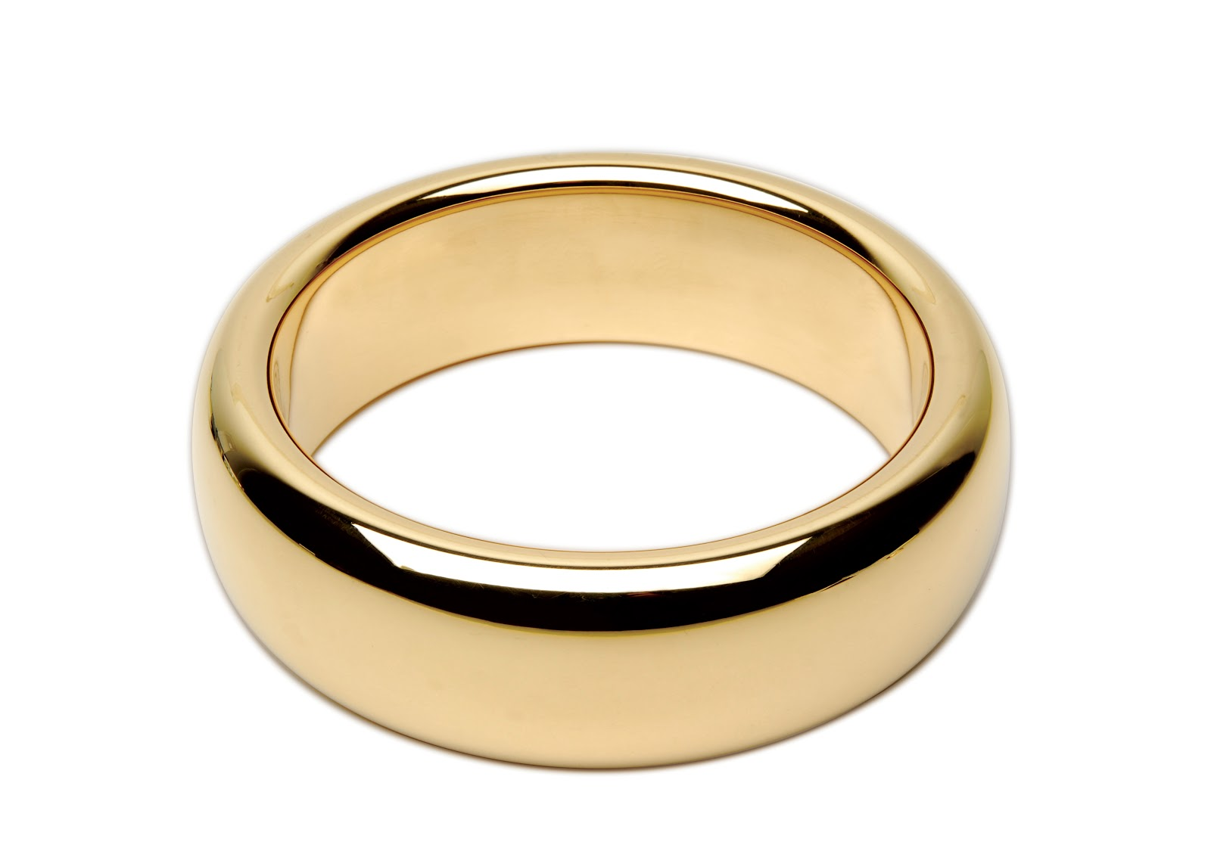
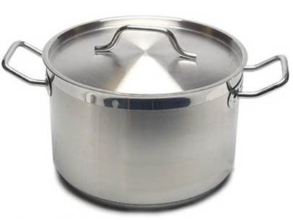
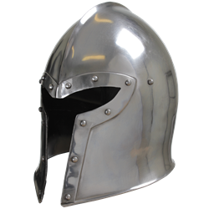
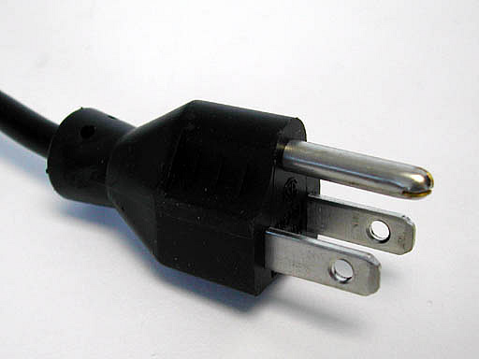
Properties of Metals
Shiny
Malleable (able to bend without breaking)
Good conductors of heat and electricity
Usually solid at room temperature
React with acid
Lose electrons to become ions
Located on the left of the PT

Slide 6
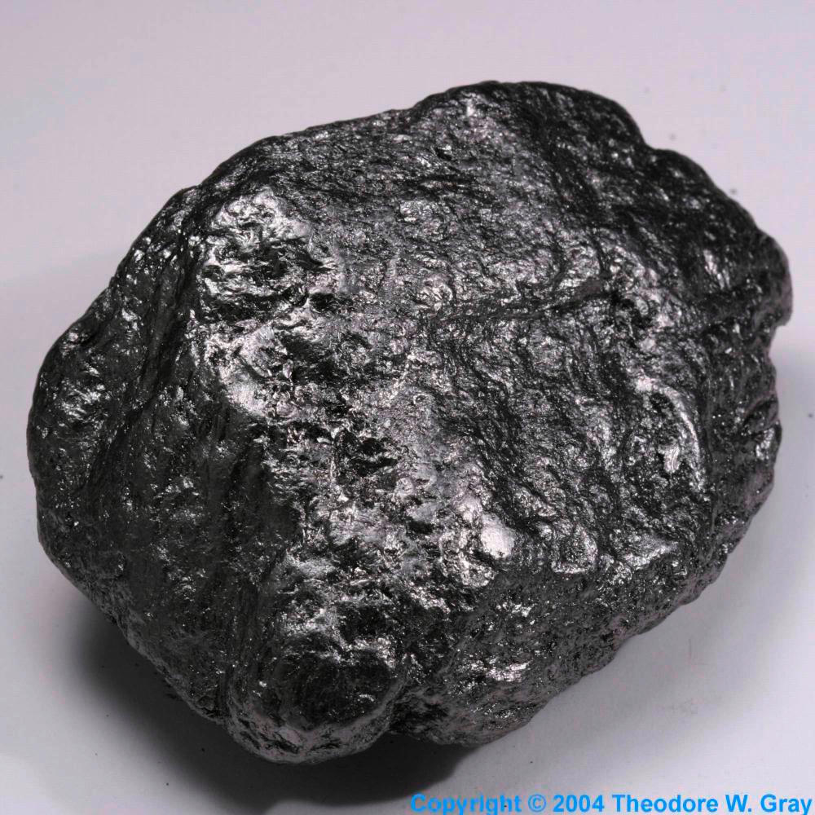
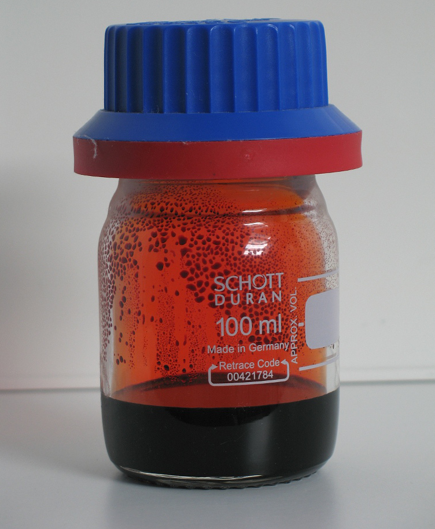
Properties of Nonmetals
Dull
Brittle (cracks or breaks when bent)
Poor conductors of heat/electricity (insulators)
Solid, liquid or gas at room temperature
Do not react with acid
Gain electrons to become ions
Located on the right of the PT

Slide 7
What about elements that do not fit into either category?
?

Slide 9
Metalloids
Metalloids: Elements that have properties of both metals and nonmetals
Located along the staircase on Periodic Table
Metalloids: B, Si, Ge, As, Sb, Te, At

Slide 10
Metalloids are often used in electronics because they are semi-conductors

Slide 11
Periodic Table Coloring
Color 1: Inert (noble) gases
Color 2: Nonmetals
Color 3: Metalloids
Color 4: Metals
BE SURE TO INCLUDE A KEY ON YOUR PERIODIC TABLE!

Slide 12
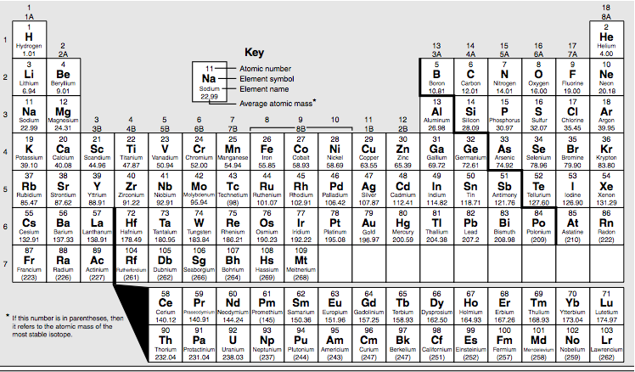
Inert (noble) gases
metalloids
nonmetals
metals

Slide 13
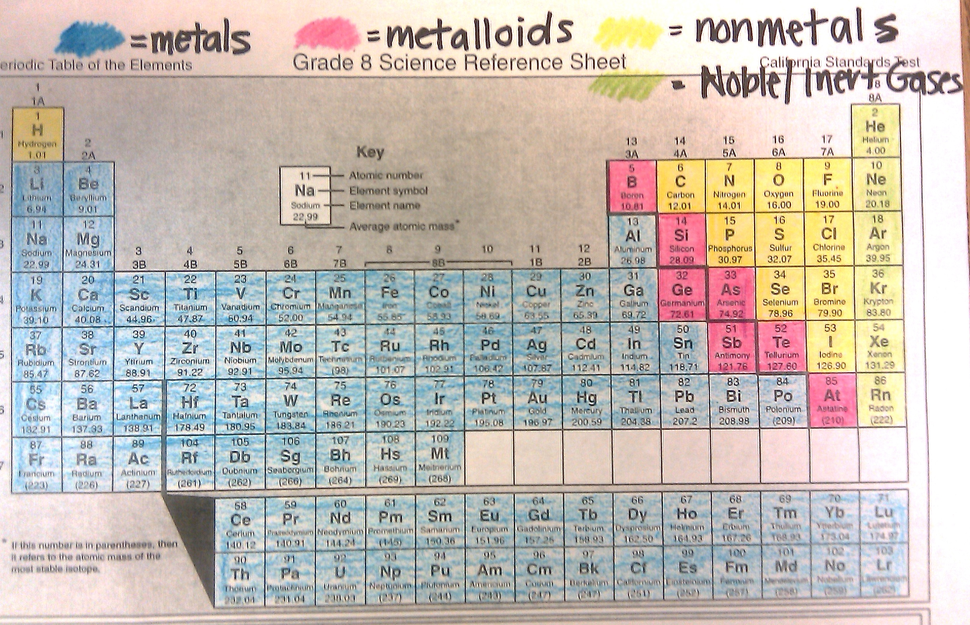

Slide 14
http://ed.ted.com/lessons/solving-the-puzzle-of-the-periodic-table-eric-rosado

Slide 15
Activity
Copy the following table into your notes. Then fill in your observations.

Slide 16
Activity
 | Appearance | Bends? | Conductive? | Rxn w/ acid | Metal/ Nonmetal
A
B
C
D
E

Slide 17
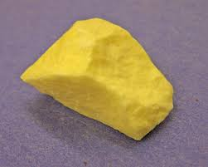
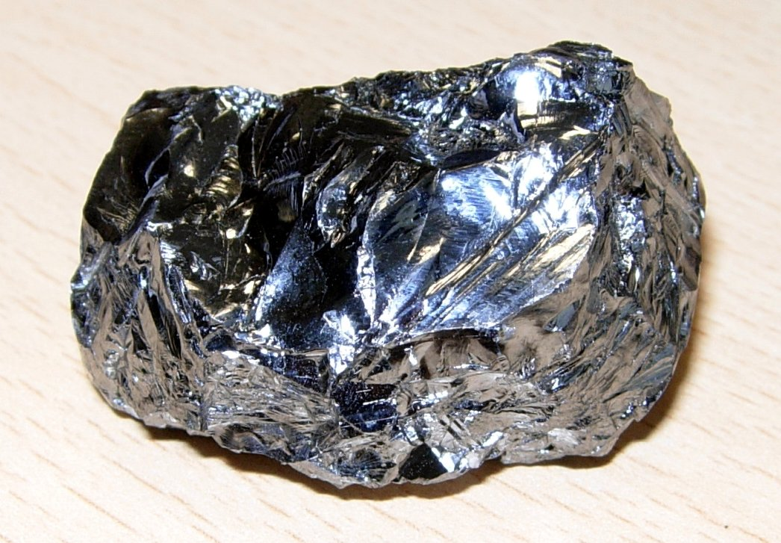
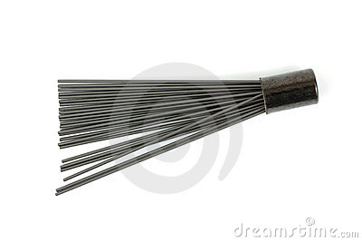
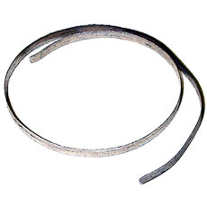
B
A
E
C
D

