Slide 1
12/8/14
Homework: Study for quiz, Agenda Qs
Objective: We will be able to explain the electron configuration of common elements.
Standard: IOD 401
Catalyst:
A. increased seed germination.
B. increased seed production per plant.
C. decreased plant survival after 1 year.
D. decreased plant survival after 2 years.
***READ THIS!!!!***
Announcements:
Tutoring this week: Tuesday and Wednesday after school
Quiz tomorrow! (PT organization, metals/nonmetals/metalloids, PT groups, electron configuration
12/8 Catalyst Chart: Week 15 81
12/8 Week 15 Agenda 82
12/8 Notes: Electron Configuration 83

Slide 2
Agenda
Catalyst/Announcements
Finish Electron Configurations POGIL
Notes

Slide 3
POGIL Review
How were model 1 and model 2 similar?
What issues are there with using the boarding house as a metaphor for electron configuration?
What does the electron configuration tell us about an atom?

Slide 4
Electron Configuration Notes
83

Slide 5
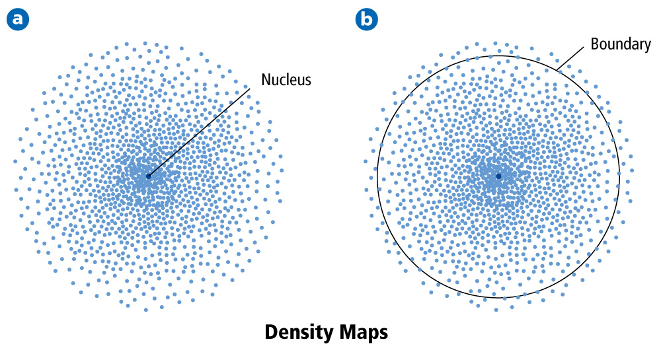
Electrons are always moving around the nucleus in energy levels.

Slide 6
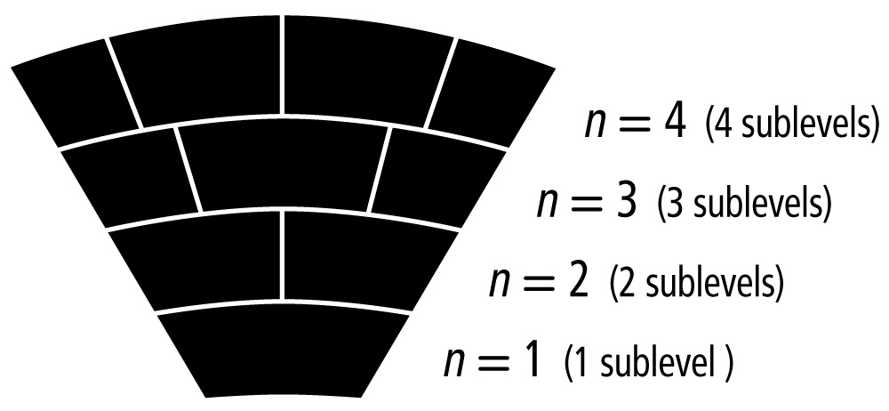
Within these energy levels, there are specific regions or sublevels where electrons are more likely to be found.

Slide 7
Example:
Hydrogen (H):
1s¹
# electrons
Energy level
sublevel

Slide 8
Energy level 1: 1 sublevel (s)
Energy level 2: 2 sublevels (s, p)
Energy level 3: 3 sublevels (s, p, d)
Energy level 4: 4 sublevels (s, p, d, f)

Slide 9
Notes:
TAPE!!!

Slide 10
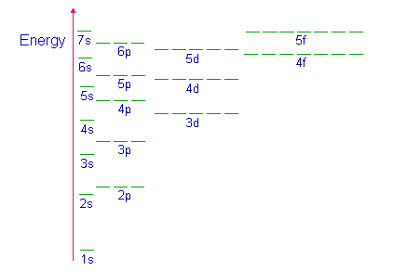
Orbital Diagrams

Slide 11
Suborbitals
Each sublevel can hold a specific number of electrons.
s: holds 2 electrons, 1 pair with opposite spins
p: holds 6 electrons, 3 pairs with opposite spins
d: holds 10 electrons, 5 pairs with opposite spins
f: holds 14 electrons, 7 pairs with opposite spins

Slide 12
Rules for Electron Configuration
Electrons fill the lowest sublevel first.
Only one electron goes in an orbital at a time before doubling up.
Only 2 electrons can be in an orbital and they must have opposite spins.

Slide 13
Example
Element: Sulfur
Electron Configuration:
Orbital Diagram:

Slide 14
Practice
Element: Potassium
Electron Configuration:
Orbital Diagram:

Slide 15
Example
Element: Cobalt
Electron Configuration:
Orbital Diagram:

Slide 16
Example
Element: Strontium
Electron Configuration:
Orbital Diagram:

Slide 17
Orbital Box

Slide 18
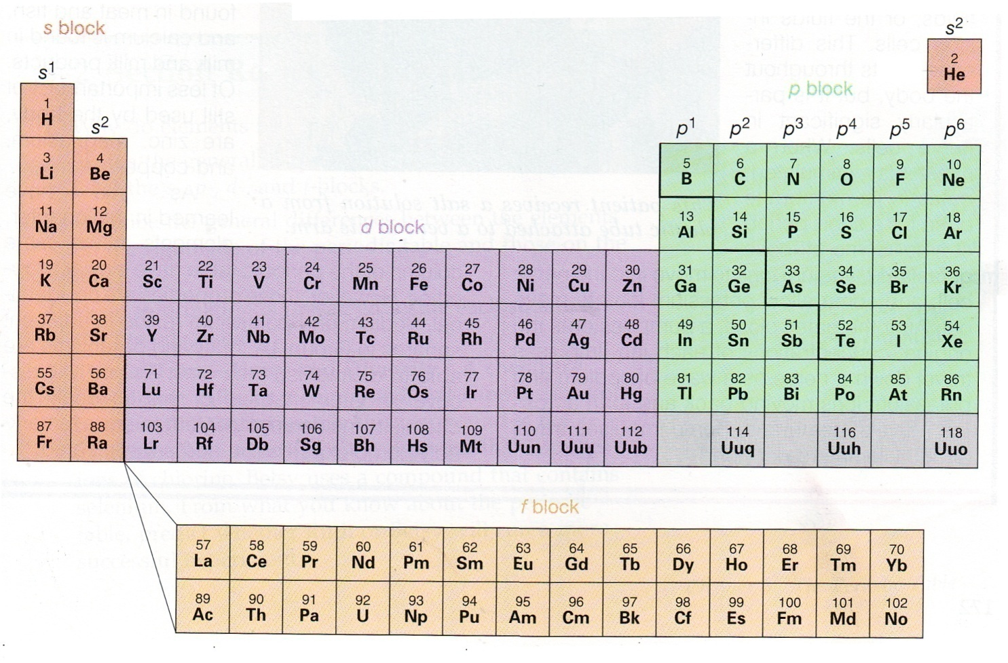
Practice
1.) Write the electron configuration for helium.

Slide 19
Practice
2.) Write the electron configuration for beryllium.

Slide 20
Practice
3.) Write the electron configuration for fluorine.

Slide 21
Practice
4.) Write the electron configuration for argon.

Slide 22
Practice
5.) Write the orbital box for boron.

Slide 23
Practice
6.) Write the orbital box for sodium.

Slide 24
Practice
7.) Write the electron configuration for oxygen.

Slide 25
Practice
8.) Write the orbital box for titanium.

