Slide 1
12/11/14
Homework: Review #1-8
Objective: We will be able to explain the trend in atomic radius on the periodic table.
Standard: SIN 402
F. preference of a different ant species for the seeds of both plant species.
G. seed preference of ants in an area in which both plant species were absent.
H. growth and survival of both plant species in an area where ants were not present.
J. effects of elaiosome mass on the seed preference of ants.
***READ THIS!!!!***
Announcements:
No tutoring today or tomorrow after school
Tutoring next week: Monday and Tuesday after school.
Test is coming: next Wednesday!
12/11 Review: Unit 4 85
12/11 Periodic Table Trends 86
12/11 Trends: Atomic Radius 87

Slide 2
12/11/14
Homework: Review #1-8
Objective: We will be able to explain the trend in atomic radius on the periodic table.
Standard: IOD 402
F. Seed mass
G. Elaiosome mass
H. Percentage of seed mass composed of elaiosome
J. Abundance of a plant in a given area
***READ THIS!!!!***
Announcements:
No tutoring today or tomorrow after school
Tutoring next week: Monday and Tuesday after school.
Test is coming: next Wednesday!
12/11 Review: Unit 4 85
12/11 Periodic Table Trends 86
12/11 Trends: Atomic Radius 87

Slide 3
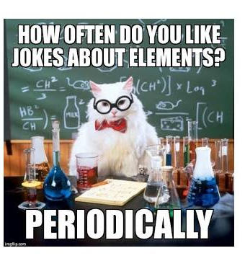

Slide 4
Agenda
Catalyst/Announcements
Coulombic Attraction Review
Periodic Table Trends Intro
Trend: Atomic Radius

Slide 5
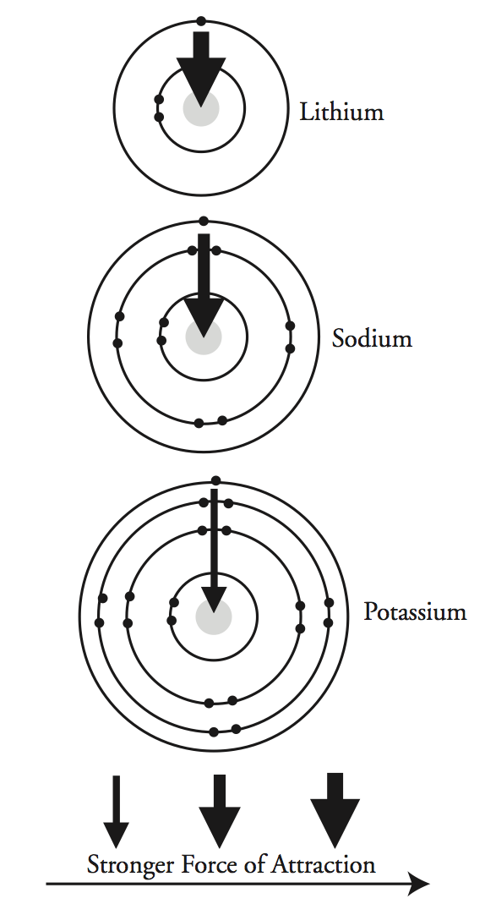
Trends
Think about it:
As you go DOWN a group the number of energy levels INCREASES
The valence electrons are farther away from the nucleus

Slide 6
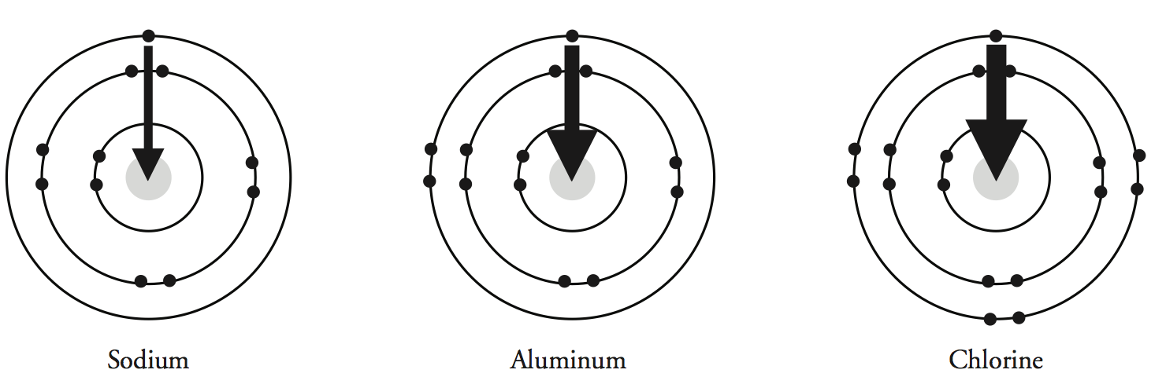
Trends
Think about it:
As you go ACROSS the period the atomic number (# of protons) INCREASES
However, the energy level with the valence electrons stays the same
Notes:
Chem team!!! I know my explanations are very over-simplified and so if you think of a better way to word these challenge questions PLEASE feel free to edit/change. ☺ I just wanted to include them because students ask these every year in class.

Slide 7
Periodic Table Trends
For Hydrogen, label what each part of the box means.
What is a trend?
Trend: a pattern of change in a set of data that can predict future points.

Slide 8
Periodic Table Trends
Think, pair, share: what trends do you notice already on this diagram?

Slide 9
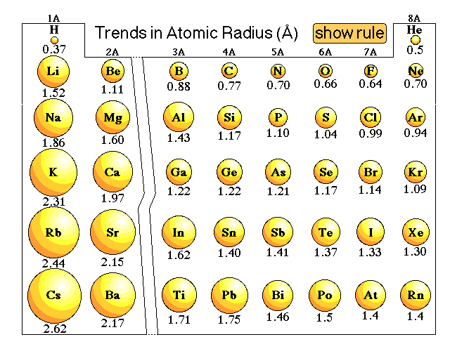
Trend #1: Atomic Radius

Slide 10
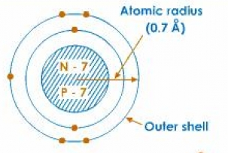
What does atomic radius mean?
The distance from the center of the nucleus to the outside of the electron cloud.

Slide 11
Atomic Radius
Look back at your trends sheet (p. 86), what trends do you notice in atomic radius on the periodic table?
Work with your partner to determine what happens as you go across a period or down a group.

Slide 12
What Causes this Trend?
Remember what we learned about coulombic attraction yesterday.
As you go across a period, what happens to the number of protons? How would this impact attraction?

Slide 13
What causes this trend?
Across a period, the number of protons increases. More protons means a greater Coulombic Attraction. More attraction means a smaller radius.

Slide 14
What Causes this Trend?
As you go across a down a group, what happens to the number of orbitals? How would this impact attraction?

Slide 15
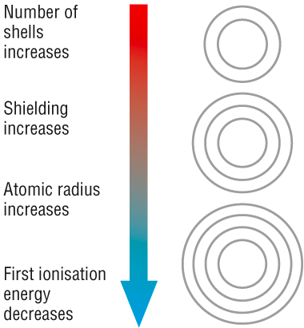
What causes this trend?
Down a group, elements have more energy levels. This means the electrons are farther away. Coulombic Attraction decreases so the radius is larger.

Slide 16
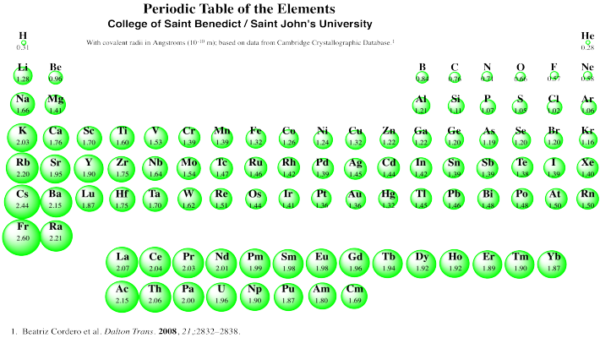
Atomic Radius
Notes:
If this trend continues for the entire periodic table, what would we expect the largest atom to be? The smallest?

Slide 17
Skills Questions
Annotate the graph. What do you notice happening? What trends do you observe? (Use your PT as well!)
Use the graph of Atomic Radius vs. Atomic Number to answer the skills questions that follow.
You will have 5 minutes to answer these independently.
Share your answers with your partner.
Discussion

Slide 18
Write
Use what you have learned today to answer the prompt provided in complete sentences.
Your answer should include specific data (numbers) and reference the trend.

