Slide 1
12/12/14
Homework: Review #9-13, organize NB
Objective: We will be able to explain the trend in ionization energy on the periodic table.
Standard: IOD 402
F. Seed mass
G. Elaiosome mass
H. Percentage of seed mass composed of elaiosome
J. Abundance of a plant in a given area
***READ THIS!!!!***
Announcements:
No tutoring today after school
Tutoring next week: Monday and Tuesday after school.
Test is coming: next Wednesday!
Notebook check: next Thursday!
12/12 Trends: Ionization Energy 88

Slide 2
12/12/14
Homework: Review #9-13.
Objective: We will be able to explain the trend in ionization energy on the periodic table.
Standard: EMI 502
A. Some plants were not present at each site.
B. Some seeds were not present at each site.
C. The seeds may have been removed from the dishes by animals other than ants.
D. The plants may have been eaten by animals other than ants.
***READ THIS!!!!***
Announcements:
No tutoring today after school
Tutoring next week: Monday and Tuesday after school.
Test is coming: next Wednesday!
Notebook check: next Thursday!
12/12 Trends: Ionization Energy 88

Slide 3
Agenda
Catalyst/Announcements
Review Atomic Radius
Trend: Ionization Energy

Slide 4
Atomic Radius
What’s the trend across a period? Why?
What’s the trend down a group? Why?

Slide 5
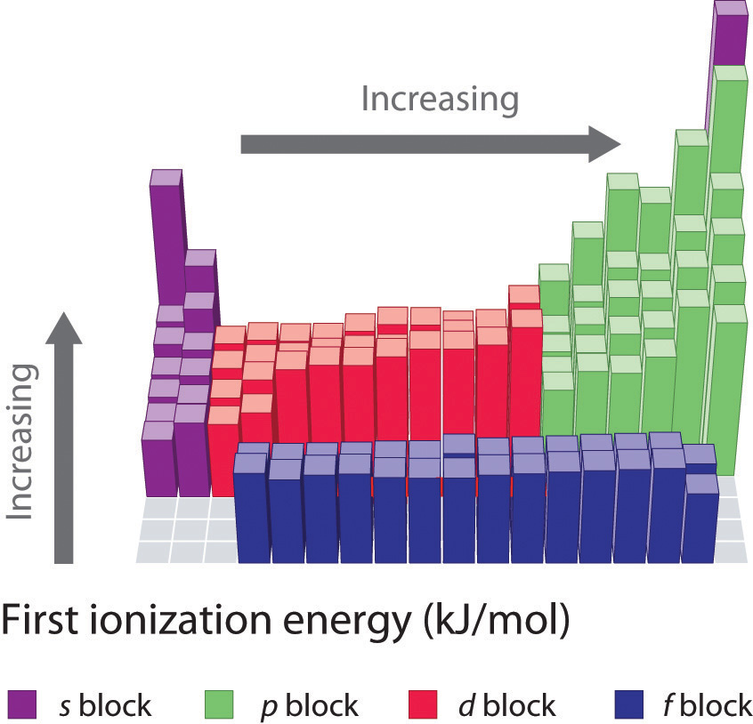
Trend # 2: Ionization Energy

Slide 6
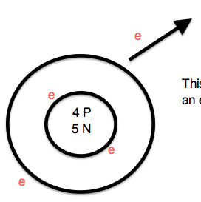
What does ionization energy mean?
The amount of energy required to remove an electron to form an ion.

Slide 7
Ionization Energy
Look back at your trends sheet (p. 86), what trends do you notice in ionization energy on the periodic table?
Work with your partner to determine what happens across a period and down a group.

Slide 8
What Causes this Trend?
Remember what we learned about Coulombic attraction.
As you go across a period, what happens to the number of protons? How would this impact attraction? Energy to remove electrons?

Slide 9
What causes this trend?
Across a period, the Coulombic Attraction increases. More attraction means electrons are harder to remove. Also, valence # increases so atoms are less likely to give up electrons.

Slide 10
What Causes this Trend?
As you go across a down a group, what happens to the number of orbitals? How would this impact attraction? Energy to remove electrons?

Slide 11
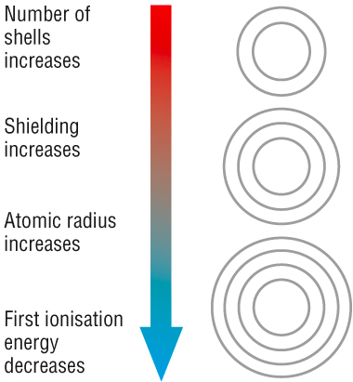
What causes this trend?
Down a group, more energy levels decrease Coulombic Attraction. Electrons are less attracted to the nucleus, so it takes less energy to remove them.

Slide 12
Connect Your Learning!
Think. Pair. Share. How does ionization energy relate to atomic radius?

Slide 13
Skills Questions
Annotate the graph. What do you notice happening? What trends do you observe? (Use your PT as well!)
Use the graph of Ionization Energy vs. Atomic Number to answer the skills questions that follow.
You will have 5 minutes to answer these independently.
Share your answers with your partner.
Discussion

Slide 15
Write
Use what you have learned today to answer the prompt provided in complete sentences.
Your answer should include specific data (numbers) and reference the trend.

