Slide 1
2/3/15
Homework: Agenda Questions 1-8, Study Polyatomic Ions!!!
Objective: We will describe the formation, structure and physical properties of a covalent bond. Standard: IOD 401
F. 5.
G. 6.
H. 8.
J. 9.
***READ THIS!!!!***
Announcements:
New Semester starts today
Re-Quiz on Polyatomics TOMORROW!
***Answer the MONDAY question. Be sure to include reasoning with your answer to receive full credit!
2/3 Catalyst Chart: Week 21 106
2/3 Week 21 Agenda 107
2/3 Defining Covalent Compounds 108

Slide 2
Agenda
Catalyst/Announcements
What is a covalent compound?
Practice

Slide 3
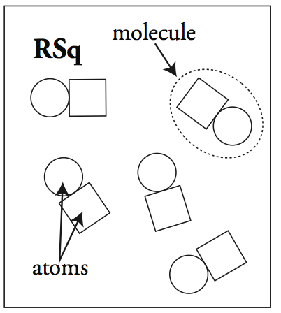
Review
Answer questions 1-5 on your worksheet on your own. You will share with a partner in a few minutes.

Slide 4
Review
1.
2. A chemical bond is a force that holds atoms together and makes them function as a unit.

Slide 5
Covalent Compounds
All covalent compounds are compound of nonmetals
All nonmetals have a high ionization energy, so they want to hold on to their electrons.

Slide 6
Covalent Compounds
Therefore, the atoms in covalent compounds share electrons.
By sharing electrons, both atoms get to count the electrons toward their full valence.

Slide 7
Example: Covalent Bonding
F
F
F
F
7 valence, needs 1
7 valence, needs 1
8 valence
8 valence
Neither atom wants to give away its valence electrons.
The atoms will share pairs of electrons so they can both have a full valence.

Slide 8
Bohr Model
F
F
F
F
Notes:
*Matter has a density. Mass/volume

Slide 9
Practice Identifying Compounds
6. a. covalent e. ionic
b. Ionic f. covalent
c. Ionic g. covalent
d. Neither h. covalent

Slide 10
Review
Fill in the table of properties for ionic compounds based on what you learned/saw in labs during the last unit.

Slide 11
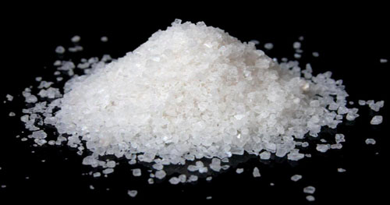
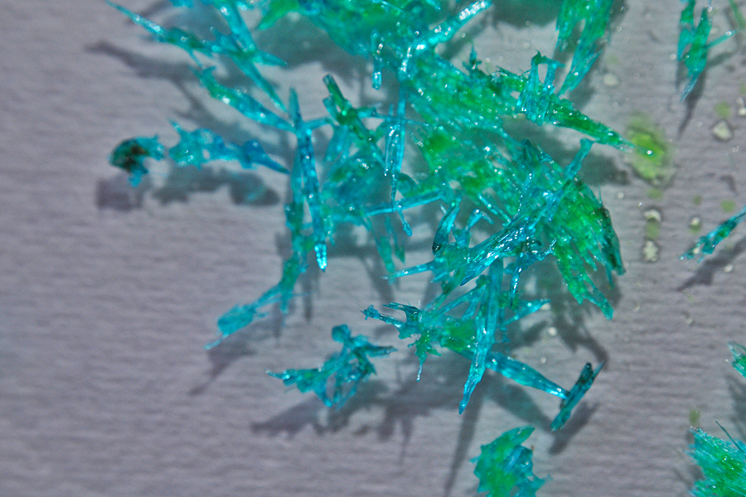
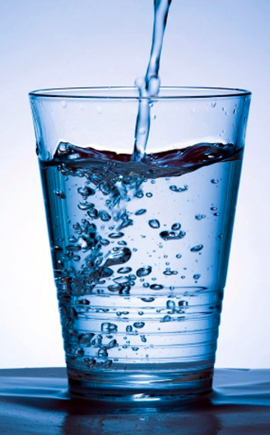
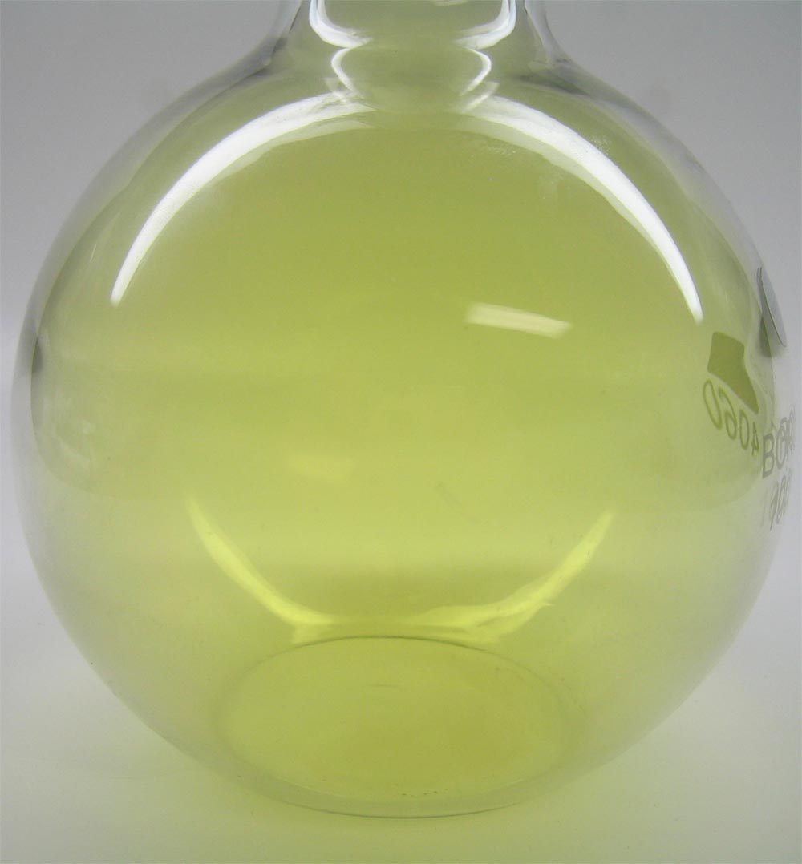
Appearance
Ionic: crystalline solids at room temperature
Covalent: gases, liquids or sometimes solids at room temperature

Slide 12
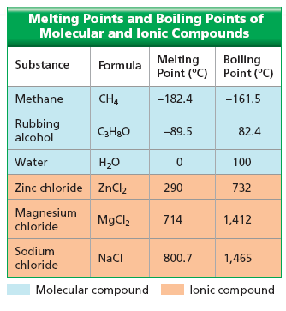
Melting/Boiling Point
Ionic: High melting/boiling points
Covalent: low melting/boiling points

Slide 13
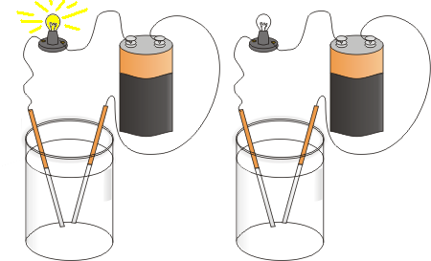
Electrical Conductivity
Ionic: Conduct electricity when melted/dissolved in water
Covalent: Always a poor conductor. Won’t dissolve in water.
NaCl in water
Just water

Slide 14
Malleability
Ionic: Brittle/not malleable
Covalent: Often liquids/gases at room temperature so very malleable

Slide 15
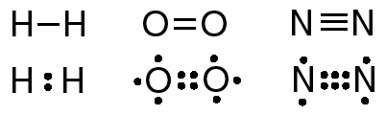
Multiple Bonds
Single Bond: 2 electrons are shared (1 pair)
Double Bond: 4 electrons are shared (2 pairs)
Triple Bond: 6 electrons are shared (3 pairs)

Slide 16
Diatomic Elements
Diatomic Elements: Elements that are found naturally as a pair
This usually means they are so reactive that they bond with themselves to avoid being alone.

Slide 17
7 Diatomic Elements
Hydrogen (H₂)
Nitrogen (N₂)
Oxygen (O₂)
Fluorine (F₂)
Chlorine (Cl₂)
Iodine (I₂)
Bromine (Br₂)

Slide 18
How do I remember these?
They are the elements ending in “-gen” and the halogens
A mnemonic is: I Never Bring Classwork Home On Fridays.

Slide 20
Activity Directions
Set out all the cards in your bag.
Find the correct combination of cards to create the compounds on your worksheet. **Be sure that all compounds you create have their bonding electrons (the ones sticking out) attached to other atoms.
Turn each pair of bonded electrons into a line to draw the compounds on your worksheet.
When you’ve created all the compounds, begin on the post-activity questions on the back of your worksheet.

