Slide 1
Tuesday, February 10th, 2015
Classroom expectations:
Wear Kenwood ID.
Cell phones, music players, and headphones are put away.
Food is disposed of or put away.
Dressed appropriately.
Notebook is out and you are ready for today’s class.
HW: Agenda Problems #3-5
Objective: We will define and describe the effects of intermolecular forces on physical and chemical properties of a substance.
Catalyst: If a beaker of distilled water and a beaker of salt water are placed on the same heating surface, which one will boil first or at a lower temperature?
***Table of Contents
2/10 Notes: Intermolecular and Intramolecular Forces 117
Notes:
Begin heating up two beakers in the front of room: 1 with distilled water only, and one concentrated with salt

Slide 2
Announcements
Tutoring Hours: Tuesday and Thursday (3:30-4:30pm)
  NO TUTORING WEDNESDAY!!
Quiz TOMORROW!
Test NEXT FRIDAY!!
Find agenda on Weebly website:
www.kachemistry.weebly.com

Slide 3
Agenda
Catalyst/Homework Check
Announcements
Intermolecular and Intramolecular Forces
  Demos
  Notes/Activity

Slide 4

Intermolecular and Intramolecular Forces
Pg.

Slide 5


Intra vs. Inter
Internet: network shared between people worldwide
  Inter: “between” or “among”
Intranet: network shared between people in a specific group. Example: CPS student portal
  Intra: “within”

Slide 6
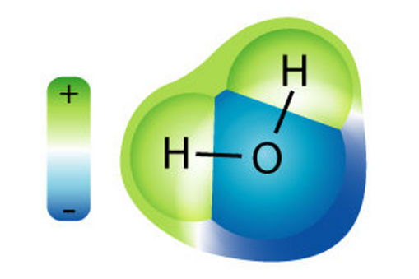
Intramolecular Forces
Forces within a molecule
  2 types: covalent & ionic
  What types of bonds are present within this H₂O molecule?
Intramolecular
Covalent

Slide 7
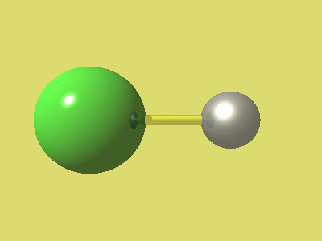
Intramolecular Forces
  What types of bonds are present within NaCl?
Intramolecular Ionic
Na⁺
Cl⁻

Slide 8
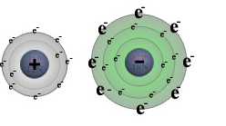
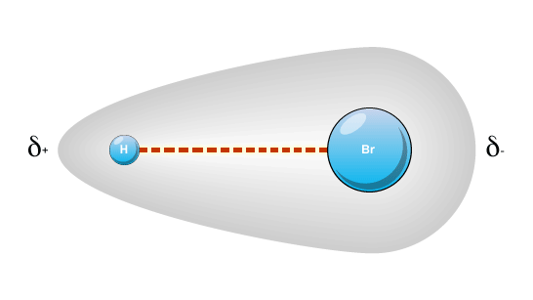
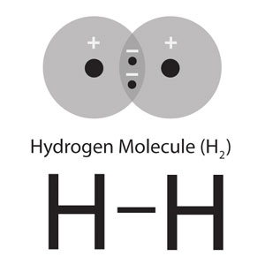
Intramolecular Forces
Bond type | Element-Type | Bond Strength
Ionic Bond | Metal - nonmetal | weak
Covalent: Polar | Nonmetal - nonmetal | strong
Covalent: Nonpolar | Nonmetal - nonmetal | strongest

Slide 9
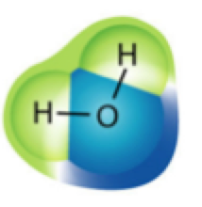
Intermolecular Forces
Forces between molecules
Much weaker than intramolecular forces
Intermolecular forces are caused by the polarity difference WITHIN a molecule
Intramolecular Force
Intermolecular Force

Slide 10
Intermolecular Forces: Inquiry
3 beakers containing different liquids will be passed around the room. (Beaker A, B, and C)
As the beakers are passed around waft the beaker and note any differences in what you smell.
  Note: DO NOT place nose directly into mouth of beaker.
Notes:
Beaker A: acetone or nail polish, Beaker B: rubbing alcohol, Beaker C: water

Slide 11
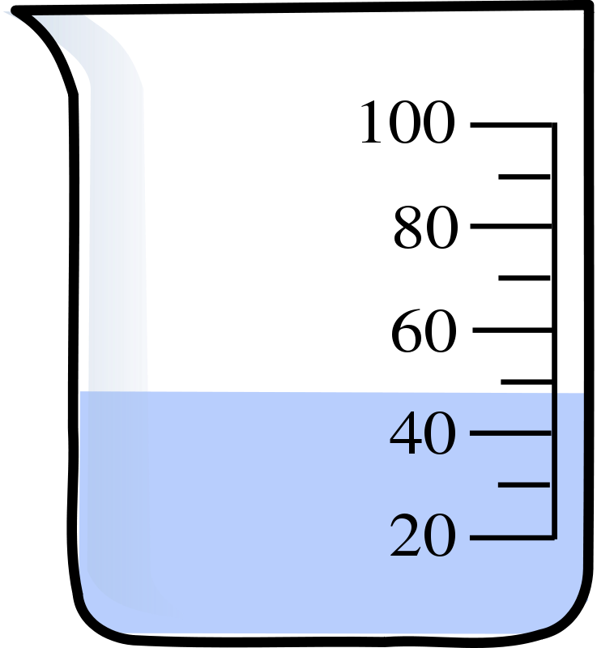
Intermolecular Forces: Inquiry
Beaker A
Beaker B
Beaker C
What did you notice about the liquids in the beakers?
Why do you think this occurred?
The difference in what you smelled were due to the INTERMOLECULAR FORCES between the molecules in each beaker.
C₃H₆O
Acetone
C₃H₇OH
Alcohol
H₂O
Notes:
Beaker A: acetone or nail polish, Beaker B: rubbing alcohol, Beaker C: water

Slide 12
Intermolecular Forces
Influence the boiling point and melting point of a substance. The stronger the force the higher the melting and boiling point.
gas
liquid
*Break through intermolecular forces when going from
a liquid to a gas– NOT intramolecular!

Slide 13
Intermolecular Forces
Based on your observations, which beaker held the substance with the weakest intermolecular forces?

Slide 14
Intermolecular Forces
4 different types of intermolecular forces exist
  Ionic
  Hydrogen
  Dipole-Dipole
  Dispersion

Slide 15
Intermolecular Forces: Card Sort
With your elbow partner take the cards out of your bag and sort them into 4 different groups.
  How did you sort the cards?
  Why did you choose to sort them this way?
Notes:
Have students sort the cards with their elbow partner: the goal is for students to sort cards based on the intermolecular forces that will be discussed right after

Slide 16
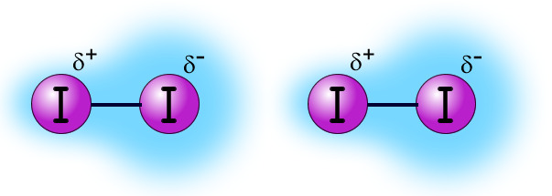
Dispersion Forces
Occur between nonpolar covalent compounds.
Result from temporary dipoles within the nonpolar molecules
Weakest intermolecular force
Examples: F---F, Cl---Cl, Br---Br
---
----
Nonpolar covalent
compound
Dispersion
Force
Nonpolar covalent
compounds

Slide 17
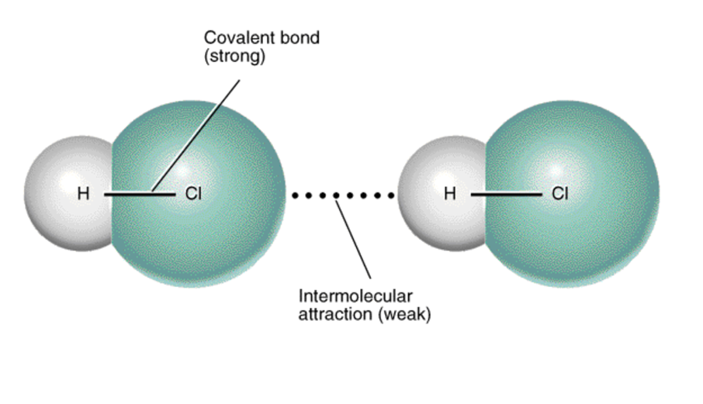
Dipole-Dipole
Occurs between molecules that have polar covalent intramolecular forces
Partially positive end of one molecule attracts the partially negative end of a neighboring molecule
Stronger than dispersion forces
Examples: C---Cl, Br---Cl, C---O
δ +
δ -
δ +
δ -
Dipole-Dipole

Slide 18
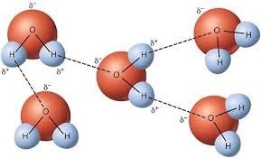
Hydrogen Bonding
A dipole-dipole interaction where the H atom is attracted to the electronegative atom of ANOTHER molecule
The H must have a large POSITIVE delta and the other atom must have a source of electrons attracted to the H
Usually F, O, N attracted to positively charged H
Hydrogen bonding is very important biologically and is why water is “sticky”
Hydrogen Bonding

Slide 19
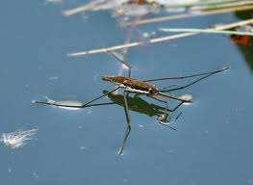
Demo: Hydrogen Bonding
Hydrogen Bonding is VERY important biologically
  Hydrogen bonds hold DNA strands together
  Hydrogen bonds are responsible for determining shape of folded proteins
  Hydrogen bonds give water a greater viscosity (“stickiness”), which allows it to be a universal solvent.
    This stickiness can be weakened
    when the correct “force” is
    present
      Let’s test this theory
Notes:
Demo with paperclip on surface of water. Shows that stickiness allows things to sit at the top of the surface. Once the paperclip is floating on the surface, add a few drops of soap which will weaken the hydrogen bonds, making the paperclip sink to the bottom.
Note: there are you tube videos available that show the paperclip floating. The most successful ones used a piece of paper towel and placed the paper towel at the top of the water. The paperclip is placed on top of the towel and when the towel sinks to the bottom, the paperclip is left floating at the top.

Slide 20
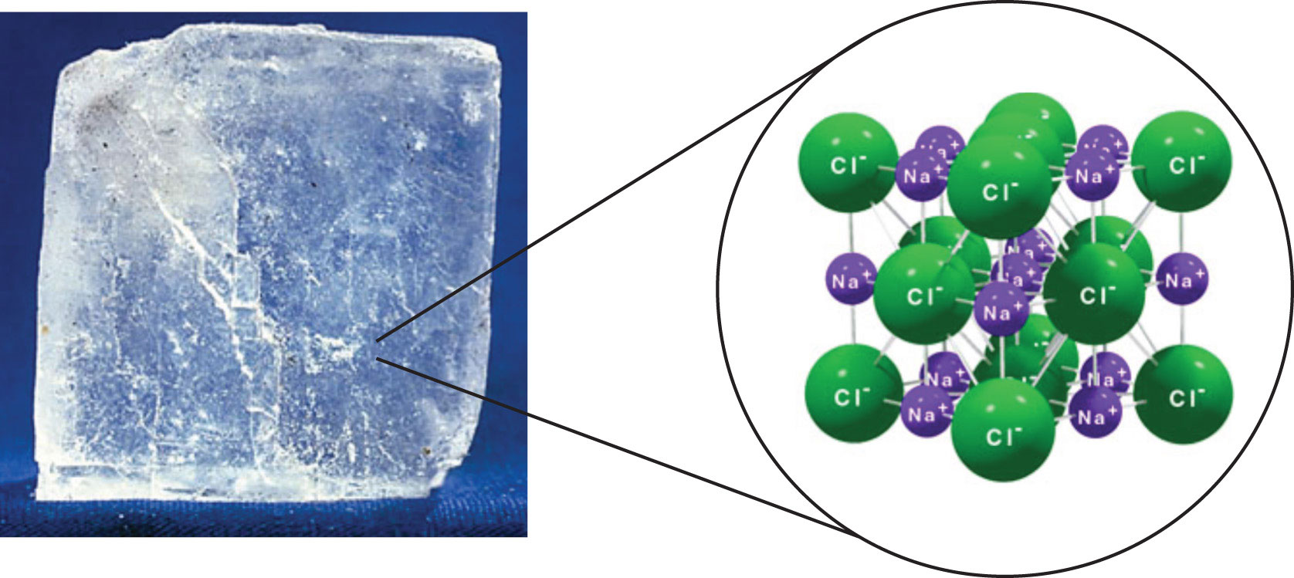
Ionic Intermolecular Forces
Occur between ionic compounds
Strongest attraction due to the positive and negative ions
Crystal lattice structure formed due to attraction between molecules
Examples: Na---Cl, K---Br, Ca---Cl

Slide 21
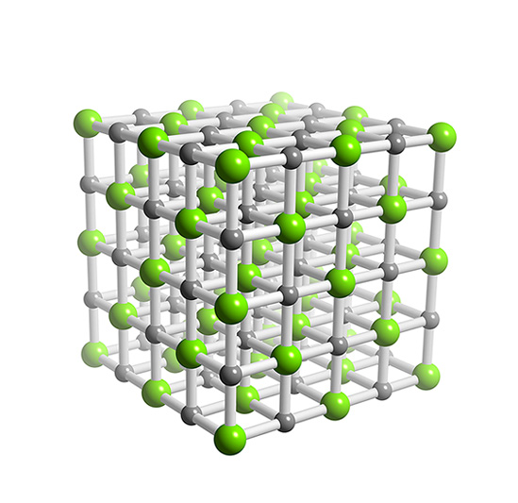
Intermolecular Forces
Intramolecular Bond | Intermolecular Force | Force Strength
Ionic | Ionic Force | strongest
Covalent: Polar | Hydrogen Bonding | weak
Covalent: Polar | Dipole-Dipole | weak
Covalent: Nonpolar | Dispersion | weakest

Slide 22
Distilled Water vs. Salt Water
Which beaker of water began boiling first?
Based on what you learned what forces were present in the distilled water?
Based on what you learned what forces were present in the distilled water?
Based on what you learned what forces were present in the salt water?

Slide 23
Distilled Water vs Salt Water
Distilled Water
Salt Water
Forces present in distilled water:
  Dipole-Dipole
  Hydrogen
Forces present in salt water:
  Dipole-Dipole
  Hydrogen
  Ionic
Notes:
So, this is not REALLY what is happening, but going into a deeper discussion could cause more confusion and I think a surface level discussion can work at this moment.

Slide 24
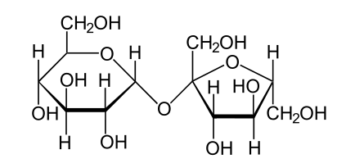
Explain: Elbow Partner Discussion
Based on what you know now, why did the sucrose (table sugar) have a lower melting point than NaCl (table salt) in the lab you performed last week? Explain using the vocabulary from the lesson.
Sucrose
NaCl

Slide 25
Exit Ticket
Idk Mastered
1 2 3 4 5
Answer the following questions:
1.) Rank the following intermolecular forces from strongest to weakest: dispersion, hydrogen, ionic, dipole-dipole
2.) What forces would be present in a container of sugar water vs a glass of salt water? Based on these forces, which container would evaporate first?

