Slide 1
Thursday, November 6th, 2014
HW= Week 10 Agenda Questions, and Valence Wkst
Objective: We will be able to identify if a substance is a homogenous or heterogeneous mixture.
Standard: IOD 403
Catalyst: If the researchers also received this data about electronegativity, as well, how does the electronegativity change, from N to F, in comparison to electron affinity?
Classroom expectations:
Wear Kenwood ID.
Cell phones, music players, and headphones are put away.
Food is disposed of or put away.
Dressed appropriately.
Notebook is out and you are ready for today’s class.
Table of Contents:
11/6 NOTES: Bohr Model 64
11/6 Valence Electron Worksheet 65

Slide 2
Thursday, November 6th, 2014
HW= Week 10 Agenda Questions, and Valence Wkst (Models ONLY)
Objective: We will be able to identify if a substance is a homogenous or heterogeneous mixture.
Standard: IOD 403
Catalyst: If the researchers also received this data about electronegativity, as well, how does the electronegativity change, from N to F, in comparison to electron affinity?
Classroom expectations:
Wear Kenwood ID.
Cell phones, music players, and headphones are put away.
Food is disposed of or put away.
Dressed appropriately.
Notebook is out and you are ready for today’s class.
Table of Contents:
11/6 NOTES: Bohr Model 60
11/6 Valence Electron Worksheet 61

Slide 3
Announcements
All late work must be turned in while you are in class TODAY.
No tutoring next week!!

Slide 4
Agenda
Catalyst/Homework Check
Announcements
Elements Quiz #2
Bohr Models
Start Valence Worksheet

Slide 5
Bohr Models
Pg 60

Slide 6
Atom Video
We know electrons move around the nucleus in the electron cloud.
https://www.youtube.com/watch?v=lP57gEWcisY
But a 3-D model is hard to draw…

Slide 7
Bohr Models
Rutherford’s model of the atom couldn’t explain why unique colors were obtained by atoms of different elements when heated.
Bohr proposed that electrons are in orbits and when excited they jump to a higher orbit. When they fall back to the original orbit, they give off light.

Slide 8
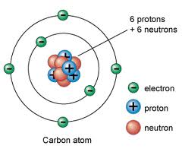
Bohr's model:
-electrons orbit the nucleus like planets orbit the sun

Slide 9
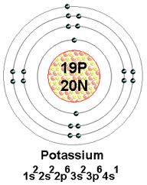
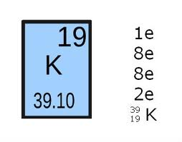
-Each orbit can hold a specific maximum number of electrons

Slide 10
orbit | maximum # electrons
1 | 2
2 | 8
3 | 18
4 | 32

Slide 11
Bohr’s Model of the Atom
Electrons fill orbits closest to the nucleus first.
The electrons in the outermost level are known as VALENCE electrons.

Slide 12
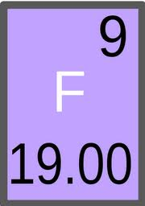
Example: Bohr's Model of the Atom
Fluorine. :
#P =
#e⁻ =
#N =

Slide 13
Example: Bohr's Model of the Atom
Fluorine:
#P = atomic #
= 9
#e⁻ =
#N =

Slide 14
Example: Bohr's Model of the Atom
Fluorine:
#P = 9
#e⁻ = # P
= 9
#N =

Slide 15
Example: Bohr's Model of the Atom
Fluorine:
#P = 9
#e⁻ = 9
#N = atomic mass - # P
= 10

Slide 16
Example: Bohr's Model of the Atom
Fluorine:
#P = 9
#e⁻ = 9
#N = 10
Draw the nucleus with
protons & neutrons
9P
10N

Slide 17
Example: Bohr's Model of the Atom
Fluorine:
#P = 9
#e⁻ = 9
#N = 10
How many electrons can
fit in the first orbit?
9P
10N

Slide 18
Example: Bohr's Model of the Atom
Fluorine:
#P = 9
#e⁻ = 9
#N = 10
How many electrons can
fit in the first orbit?
2
9P
10N

Slide 19
Example: Bohr's Model of the Atom
Fluorine:
#P = 9
#e⁻ = 9
#N = 10
How many electrons are left?
9P
10N

Slide 20
Example: Bohr's Model of the Atom
Fluorine:
#P = 9
#e⁻ = 9
#N = 10
How many electrons are left? 7
9P
10N

Slide 21
Example: Bohr's Model of the Atom
Fluorine:
#P = 9
#e⁻ = 9
#N = 10
How many electrons are left? 7
How many electrons fit in the
second orbit?
9P
10N

Slide 22
Example: Bohr's Model of the Atom
Fluorine:
#P = 9
#e⁻ = 9
#N = 10
How many electrons are left? 7
How many electrons fit in the
second orbit? 8
9P
10N

Slide 23
Example: Bohr's Model of the Atom
Fluorine:
#P = 9
#e⁻ = 9
#N = 10
How many valence electrons are present?
7
9P
10N

Slide 24
Whiteboard Practice
Draw each atom on your whiteboard.

Slide 25
Bohr's Model of the Atom
Hydrogen
1P
0N
How many valence electrons are present?

Slide 26
Bohr's Model of the Atom
Boron
5P
6N
How many valence electrons are present?

Slide 27
Bohr's Model of the Atom
Magnesium
12P
12N
How many valence electrons are present?

Slide 28
Valence Electrons WS
This worksheet is homework if not finished in class.

