Slide 1
Monday, October 20th, 2014 (Week 8)
Homework: 17.3 Textbook Reading with Outline (due Friday); Week 8 Agenda Problems
Objective: : We will be able to read and interpret a graph for the heating curve of water.
Catalyst: If you are given the value for heat how do you know if the substance GAINED or RELEASED energy based on the given value?
Classroom expectations:
Wear Kenwood ID.
Cell phones, music players, and headphones are put away.
Food is disposed of or put away.
Dressed appropriately.
Notebook is out and you are ready for today’s class.

Slide 2
Announcements
Unit 2 Exam WEDNESDAY!!!
Tutoring
Monday: 3:30-4:30
Tuesday: 3:30-4:30
Late Lab Reports/17.1 Textbook Outline Due by Wednesday for partial credit!!!

Slide 3
Agenda
Catalyst
Notebook Update
Notes: Heat in Phase Changes

Slide 4
Table of Contents
Page Title Date
Reading and Notes: Endothermic vs 10/16
Exothermic Reactions
Bomb Calorimeter Skills Practice 10/17
Week 8 Catalyst 10/20
Week 8 Agenda 10/20
Notes: Heat in Phase Changes 10/20
ACT Passage: Heating Curve 10/20

Slide 5
Table of Contents
Page Title Date
Week 7 Catalyst Chart 10/14
Week 7 Agenda Sheet 10/14
Calorimetry Lab 10/14
Notes: Endothermic vs. Exothermic 10/16
Bomb Calorimeter Skills Practice 10/17
Week 8 Catalyst 10/20
Week 8 Agenda 10/20
Notes: Heat in Phase Changes 10/20
ACT Passage: Heating Curve 10/20

Slide 6
Predictions
Fill in the top of the notes sheet you picked up today (pg. 44 of your NB).

Slide 7
Predictions
Fill in the top of the notes sheet you picked up today (pg. 41 of your NB).

Slide 8
Observe/Explain
After the 5 minutes, the temperature of the water didn’t change. However, was energy being added? What happened to the energy?

Slide 9
Graph
At what temperature does water freeze in degrees Celsius?
At what temperature does water boil in degrees Celsius?

Slide 10
Pair
Read questions 1-8 and try to answer the questions to the best of your ability with your elbow partner.

Slide 11
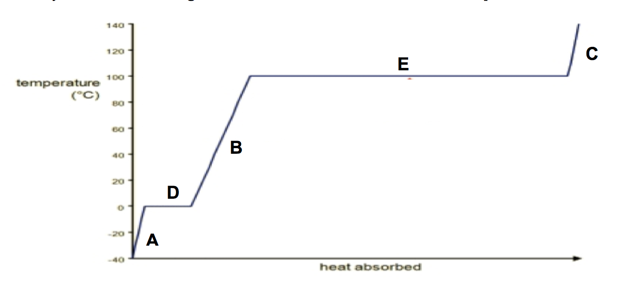
Heating Curve of Water
Boiling (Evaporation) →
← Condensing
gas
Melting →
← Freezing
liquid
solid

Slide 12
Key Point
Think about the equation for heat energy (Q=CmΔT). Why doesn’t this equation work during parts D and E on the graph?

Slide 13
Latent Heat
Latent Heat occurs during a phase change when temperature is constant.

Slide 14
Types of Latent Heat
Heat of Vaporization (ΔH_{v}) = The amount of heat needed to change state from a liquid to a gas.
*Note: If a substance changes phase from a gas to a liquid ΔH_{v} is negative because the substance RELEASED energy.

Slide 15
Types of Latent Heat
Heat of Fusion (ΔH_{f})= The amount of heat needed to change state from a solid to liquid.
*Note: If a substance changes phase from a liquid to a solid ΔH_{f} is negative because the substance RELEASED energy.

Slide 16
Equations
Q = m × ΔH_{v}
Q = m × ΔH_{f}

Slide 17
Heating Curve of Water
Q = m•ΔH_{V} →
← Q =m•-ΔH_{V}
Q = m•c•ΔT
Boiling (Evaporation) →
← Condensing
gas
Q = m•ΔH_{f} →
← Q =m•-ΔH_{f}
Melting →
← Freezing
liquid
Q = m•c•ΔT
solid
Q = m•c•ΔT

Slide 18
Practice Problems
Let’s look at #1 and #2 together!!
Then you will complete the rest on your own, asking your elbow partner for assistance when necessary.

