Slide 1
Tuesday, November 18th, 2014
HW= Unit 3 Review Problems #11-20
Objective:We will complete a POGIL to understand the how IONS are formed.
Catalyst (Answer Choices):
F. 3 kb 800°C
G. 5 kb 400°C
H. 8 kb 1,000°C
J. 11 kb 600°C
Standard: IOD 401
Classroom expectations:
Wear Kenwood ID.
Cell phones, music players, and headphones are put away.
Food is disposed of or put away.
Dressed appropriately.
Notebook is out and you are ready for today’s class.
Table of Contents
11/18 POGIL: Ions 74

Slide 2
Tuesday, November 18th, 2014
HW= Unit 3 Review Problems #11-20
Objective:We will complete a POGIL to understand the how IONS are formed.
Catalyst (Answer Choices):
F. medium
G. low to medium
H. medium to high
J. high
Standard: IOD 401
Classroom expectations:
Wear Kenwood ID.
Cell phones, music players, and headphones are put away.
Food is disposed of or put away.
Dressed appropriately.
Notebook is out and you are ready for today’s class.
Table of Contents
11/18 POGIL: Ions 69

Slide 3
Announcements
Tutoring this week: TODAY and WEDNESDAY ONLY
Test FRIDAY!!!!
Notebook Check before break!!

Slide 4
Agenda
Catalyst/Announcements
Homework Check/Review
The POGIL Project: Ions

Slide 5
Homework (Practice Wkst)
63.55 amu
32.06 amu
206.70 amu
24.32 amu

Slide 6
Unit 3 Review #1-10
Rubidium
Indium, Krypton, Copper, Potassium, Magnesium
No because the 22 protons identify the atom as Titanium
Protons = Electrons in a neutral atom
Neutrons and Protons contribute to the atoms mass and are found in the nucleus.
Isotopes form because the amount of neutrons in the atom changed.
Oxygen-16: 8p, 8e, 8n
Oxygen-17: 8p, 8e, 9n
Oxygen-18: 8p, 8e, 10n
65 amu
126.86 amu

Slide 7
The POGIL Project
POGIL: Process Oriented Guided Inquiry Learning
Developed to help students take ownership of their learning by working in learning groups

Slide 8
The POGIL Project
Learning Group Roles:
Facilitator
Quality Control
Process Analyst (fills out exit ticket…BE HONEST…we are watching!!)
Spokesperson (asks ALL questions for the group)
ONLY ONE packet will be collected per group!!

Slide 9
Annotate
Look over Model 1 quietly. Annotate any questions you have, patterns you notice, and note any information that jumps out at you and seems important.
Be prepared to share your annotations with the class!

Slide 10
Share
Share annotations.

Slide 11
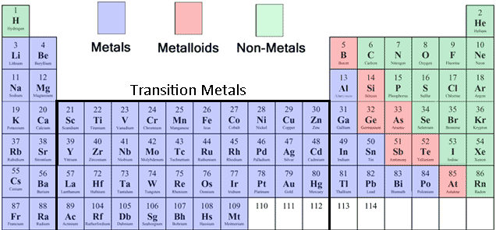
Before You Begin
*Note this on your PT!

Slide 12
Ions POGIL
Work in the same groups as last time. This time switch roles.
The spokesperson may ask Ms. Ingham up to 2 questions before points are deducted from the whole group!

Slide 13
Quality Control add responses!
Group Name | 2 | 3a | 6 ✓ | 7 ✓ | 9a | 11c
Group 1
Group 2
Group 3
Group 4
Group 5
Group 6
Group 7

Slide 14
Period 1
Group 1: Austin Maxine Xiaolin Alana | Group 2: Amari Indya Kaytlyn Tosan | Group 3: Ayanna Jalisa Shanti Amira Jaylen | Group 4: Temirlan Nia Ciara Erin S.
Group 5: Vania Rebecca L Ernst Nima | Group 6: Jaleyia Dominic Erin G. Reginald | Group 7: Brian Fabian Kayla Rebecca T

Slide 15
Period 2
Group 1: Destiny B. Tyler R Alex | Group 2: Lovette Destiny L. Javarus | Group 3: Tyler L. Max Monique | Group 4: Desiree Troy Sarah Tsz Yan
Group 5: Sheridan Kevin Georgia | Group 6: Samala Brian Mike Quiona | Group 7:

Slide 16
Period 5
Group 1: Derrick Brandon Marilyn Salim Kelly | Group 2: Taya Lujeine Bryce Mark | Group 3: | Group 4: Nikiya Lolita Sade Jabari
Group 5: Qamar Kourtney Jeremy Nykara | Group 6: Joel Tacara Kejia Aminah | Group 7: Kei’Avion Khrystin Zion Justice Lariece

Slide 17
How can a student lose participation points?
Moving away from their group’s table
Talking at a loud level of voice
Arguing with their group members
Not staying on task with their group members

Slide 18
Period 7
Group 1: | Group 2: | Group 3: | Group 4:
Group 5:

Slide 19
Period 8
Group 1: Malik Daizjonay Jackson Tierra | Group 2: A-1 Garrett Tkeyah | Group 3: Michelle Kennedi Knowledge Tyler Bo. | Group 4: Javan Brandi Sanquia
Group 5: Taylor Trevon Armani | Group 6: Tyler Bl. Cameron Kat | Group 7: Derrick Ramaan Assata Akia

Slide 20
Exit Ticket
Process Analyst fill out exit slip on your group’s behalf.

