Slide 1
Wednesday, November 19th, 2014
HW= Finish Unit 3 Review
Objective: We will be able to explain why atoms form ions and draw Bohr models to illustrate this process.
Standard: IOD 504
Catalyst Answer Choices:
A. decreases only.
B. remains the same.
C. increases only.
D. increases, then decreases.
Classroom expectations:
Wear Kenwood ID.
Cell phones, music players, and headphones are put away.
Food is disposed of or put away.
Dressed appropriately.
Notebook is out and you are ready for today’s class.
Table of Contents:
11/19 Classwork: Ions 75

Slide 2
Wednesday, November 19th, 2014
HW= Unit 3 Review #21-24; #1-2
Objective: We will be able to explain why atoms form ions and draw Bohr models to illustrate this process.
Standard: IOD 202
Catalyst Answer Choices:
A. Pressure
B. Temperature
C. Metamorphic Grade
D. Depth
Classroom expectations:
Wear Kenwood ID.
Cell phones, music players, and headphones are put away.
Food is disposed of or put away.
Dressed appropriately.
Notebook is out and you are ready for today’s class.
Table of Contents:
11/19 Classwork: Ions 70

Slide 3
Announcements
Last day for tutoring is TODAY!!
Test Friday!!
30 multiple choice
3 free response
Notebook check before break!!

Slide 4
Announcements
Last day for tutoring is TODAY!!
Test Monday!!
Notebook check before break!!

Slide 5
Agenda
Catalyst/Announcements
Homework Check
Review POGIL
Notes: Ions
Practice: Ions

Slide 6
Unit 3 Review Sheet
Same protons and electrons but different neutrons
An element is a pure substance made up of the same type of atom
A compound is a pure substance made u of two or more atoms that a bonded chemically. Ex: H₂O, NaCl, CO₂
A mixture is a substance made up of two or more compounds and/or elements that are NOT chemically combined.
A homogeneous mixture is one phase and the same throughout. A heterogeneous mixture is two or more phases and different throughout.
2, 8, 18
Magnesium and Sodium
Skip
2, 8, 18, 32
C: 4, Se: 6, Rb: 1, Ne: 8
Yes, because electrons in isotopes are the same while neutrons change.

Slide 7
POGIL Review
Take out your POGIL Ions packet from yesterday and be ready to answer questions if Ms. Ingham calls on you.

Slide 8
Classwork
Take out your worksheet for today’s lecture. Answer this question at the top:
In your own words what is an ion and how is it different from a neutral atom?

Slide 9
Notes
An ion is an atom with a positive or negative charge.
Occur when there is an unequal number of protons and electrons.

Slide 10
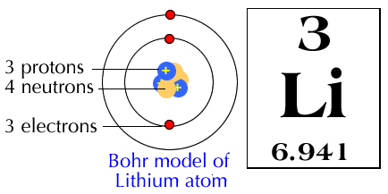
Discuss
Think about it: Lithium atoms like to form lithium ions with a +1 charge. Why can’t you add 1 proton to a lithium atom to form the lithium ion?

Slide 11
Important
Ions are created by the loss or gain or electrons.

Slide 12
Notes
Why do neutral atoms form ions?
An atom is most stable when it has a full outer shell with valence electrons. Atoms will gain or lose electrons until they are stable with a full outer shell.

Slide 13
Notes
Why do neutral atoms form ions?
Atoms will form an ion based on the original amount of valence electrons.

Slide 14
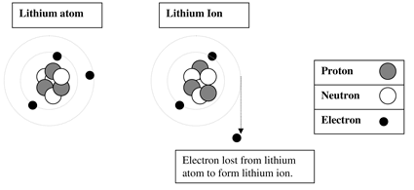
Notes
Why do neutral atoms form ions?

Slide 15
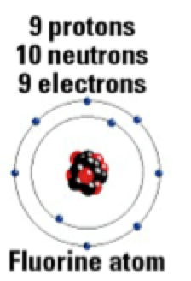
Read This
Gaining or losing electrons requires an energy exchange. Atoms will form an ion based on the smallest amount of energy required.
What are fluorine’s options for having a full outer shell?
Which do you think would take the least energy?

Slide 16
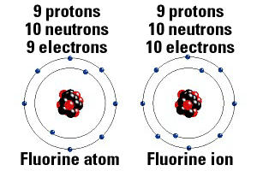
Read This
For example, it takes less energy for lithium to lose one electron instead of use enough energy to gain 7 electrons.

Slide 17
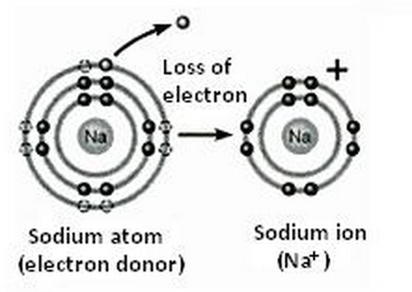
Sodium Ion
If the sodium ion loses one electron, what charge will the sodium ion have? Why?

Slide 18
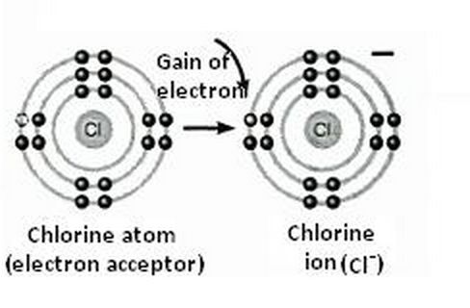
Chlorine Ion
If the chlorine ion gains one electron, what charge will the sodium ion have? Why?

Slide 19
Practice
An atom that gains 2 electrons will have a _____ charge because _________________.
An atom that loses 2 electrons will have a _____ charge because _________________.
-2
You gain 2 negative charges
+2
You lose 2 negative charges

Slide 20
Practice
An atom that loses 4 electrons will have a _____ charge because _________________.
An atom that gains 3 electrons will have a _____ charge because _________________.
+4
You lose 4 negative charges
-3
You gain 3 negative charges

Slide 21
Practice
Draw the Lewis Dot Structure for the following atoms. Then determine what ion the atom would most likely form and draw the Bohr model for the ion. Finally, determine the charge and fill in the correct information for the atomic symbol for the atom AND the ion
Notes:
*Show example on document camera.

