Slide 1
Friday, October 24th, 2014
Classroom expectations:
Wear Kenwood ID.
Cell phones, music players, and headphones are put away.
Food is disposed of or put away.
Dressed appropriately.
Notebook is out and you are ready for today’s class.
Homework: get chart signed; Week 8 Agenda Problems
Objective: We will be able to describe the components of Dalton’s Atomic Theory. We will be able to gain information from reading the period table.
Catalyst: What do you already know about “atoms”? Write as many things as you can think of.

Slide 2
Announcements
No tutoring today, however:
Come to room 301 IMMEDIATELY to sign out a Unit 2 Test to finish corrections
Ms. Ingham will leave at 3:30
Tutoring next week: Wednesday and Thursday after school
TODAY IS LAST DAY TO TURN IN LAB
Quarter ends in: 9 school days!

Slide 3
Announcements
No tutoring today
Test Corrections for Unit 2 can be done MONDAY after or before school ONLY
Tutoring next week: Wednesday and Thursday after school
TODAY IS LAST DAY TO TURN IN LAB!!
Quarter ends in: 9 school days!

Slide 4
Agenda
Catalyst
Announcements
Atomic Theory Reading
Notes
Periodic Table

Slide 5
Atomic Theory Reading
Read and annotate the provided passage.
When you are finished, answer the questions that follow the reading.

Slide 6
Table of Contents
Page Title Date
Unit 2 Review 10/21
Week 8 Textbook Reading 10/22
Reading: Atomic Theory 10/24
Notes: Periodic Table Basics 10/24

Slide 7
Periodic Table Basics
49

Slide 8
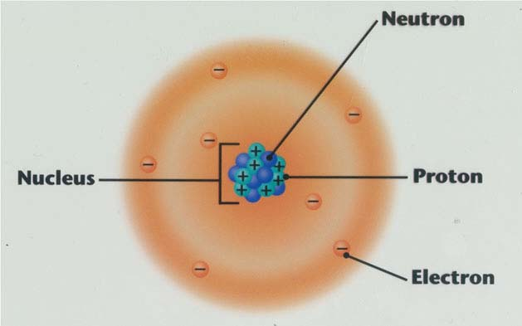
An Atom

Slide 9
Practice Questions

Slide 10
Question 1
What number tells us the number of protons in an atom?

Slide 11
Question 2
What does the atomic mass tell us?

Slide 12
Question 3
Write the symbol and # of protons, neutrons and electrons for: Potassium.

Slide 13
Question 4
Write the symbol and # of protons, neutrons and electrons for: Iodine.

Slide 14
Question 5
Which has more neutrons: Gold or Platinum?

Slide 15
Question 6
Which has more neutrons: Mercury or Lead?

Slide 16
What elements do I need to know?
Honors: Elements 1-36, 47, 50, 53, 79, 80, 82
Quiz: 11/3
Know: Name → Symbol AND Symbol → Name
SPELLING COUNTS!!!

Slide 17
What elements do I need to know?
College Bound: Elements 1-20
Quiz: 11/3
Know: Name → Symbol AND Symbol → Name
SPELLING COUNTS!!!

