Slide 1
Tuesday, February 3rd, 2015
Classroom expectations:
Wear Kenwood ID.
Cell phones, music players, and headphones are put away.
Food is disposed of or put away.
Dressed appropriately.
Notebook is out and you are ready for today’s class.
HW: Week 21 Agenda Problems #1, 2, 4
Objective: We will apply the octet rule to explain the formation and structure of a covalent bond.
Catalyst:
Change in temperature causes Enzyme A to have the greatest acceleration factor
Change in enzyme concentration causes Enzyme B to have the greatest acceleration factor
Change in substrate concentration causes Enzyme B to have the greatest acceleration factor
Enzyme A has a greater acceleration factor in acidic solution while Enzyme B has a greater acceleration factor in basic solution
***Table of Contents
2/3 Week 21 Catalyst Chart 107
2/3 Week 21 Agenda 108
2/3 Notes: Covalent Bonds and Diatomic Molecules 109

Slide 2
Tuesday, February 3rd, 2015
Classroom expectations:
Wear Kenwood ID.
Cell phones, music players, and headphones are put away.
Food is disposed of or put away.
Dressed appropriately.
Notebook is out and you are ready for today’s class.
HW: Week 21 Agenda Problems #1, 2, 4
Objective: We will apply the octet rule to explain the formation and structure of a covalent bond.
Catalyst:
A. less than 0.80 kS/cm.
B. between 0.80 kS/cm and 2.30 kS/cm.
C. between 2.30 kS/cm and 3.80 kS/cm.
D. greater than 3.80 kS/cm.
***Table of Contents
2/3 Week 21 Catalyst Chart 101
2/3 Week 21 Agenda 102
2/3 Notes: Covalent Bonds and Diatomic Molecules 103

Slide 3
Announcements
Tutoring this week: WEDNESDAY and THURSDAY
Quiz: NEXT week TUESDAY

Slide 4
Agenda
Catalyst/Announcements
New Semester Items
Notes: Covalent Bonds and Diatomic Molecules

Slide 5
New Semester Items
Use of popsicle sticks
Volunteer for participation points
Detentions for behavior

Slide 6
To Do
Answer the REVIEW question on your guided notes sheet with your elbow partner.

Slide 7
To Do
Draw the Lewis Dot Structures for the atoms on your guided notes sheet.
Answer the NEXT TWO questions below the Lewis Dot Structures with your elbow partner.

Slide 8
Notes: Covalent bonds
109

Slide 9
Remember…
A chemical bond: A force that holds two or more atoms together.
Ionic bonds – transfer of electrons example: NaCl

Slide 10
Example: Covalent Bonding
Fluorine has seven valence electrons (but would like to have 8)
F

Slide 11
Example: Covalent Bonding
Fluorine has seven valence electrons
A second atom also has seven
F
F

Slide 12
Example: Covalent Bonding
Fluorine has seven valence electrons
A second atom also has seven
By sharing electrons…
F
F

Slide 13
Example: Covalent Bonding
Fluorine has seven valence electrons
A second atom also has seven
By sharing electrons…
F
F

Slide 14
Example: Covalent Bonding
Fluorine has seven valence electrons
A second atom also has seven
By sharing electrons…
F
F

Slide 15
Example: Covalent Bonding
Fluorine has seven valence electrons
A second atom also has seven
By sharing electrons…
F
F

Slide 16
Example: Covalent Bonding
Fluorine has seven valence electrons
A second atom also has seven
By sharing electrons…
F
F

Slide 17
Example: Covalent Bonding
Fluorine has seven valence electrons
A second atom also has seven
By sharing electrons…
…both end with full orbitals
F
F

Slide 18
Example: Covalent Bonding
Fluorine has seven valence electrons
A second atom also has seven
By sharing electrons…
…both end with full orbitals
F
F
8 Valence electrons

Slide 19
Covalent bonding
All atoms want a 8 valance electrons
If an atom cannot take the electron (ionic) they will share with another atom so…
…both end with full orbitals
F
F
8 Valence electrons

Slide 20
Covalent bonding
Can also be drawn with a line between the two atoms
Each atom has a total of 8 valence electrons shared between them.
F
F

Slide 21
Covalent Compounds
All covalent compounds are composed of non-metals ONLY
Do non-metals usually have a high or a low electronegativity?

Slide 22
Covalent Compounds
Do non-metals usually have a high or a low electronegativity?
All nonmetals have high electronegativities, so they want to gain valence electrons.

Slide 23
Covalent Compounds
Therefore, the atoms in covalent compounds gain electrons by sharing
By sharing electrons, all atoms obtain a full valence level of 8 electrons (except for Hydrogen)
How many electrons does Hydrogen want for a full valence level?

Slide 24
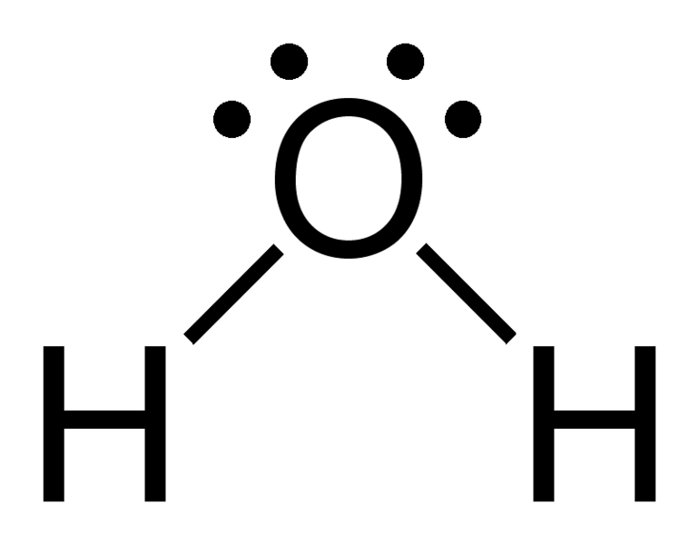
Covalent Compounds
Covalent compounds are also called molecules
A molecule: 2 or more nonmetal atoms that are bonded using covalent bonds
Example: H₂O

Slide 25
Practice
Complete the practice problems at the bottom of your worksheet.

Slide 26
Practice
Complete the practice problems at the bottom of your worksheet.
NO₂ = covalent e. MgBr₂ = ionic
NaCl = ionic f. PO₄³⁻ = covalent
CaO = Ionic g. H₂O = covalent
CuZn = neither h. O₂ = covalent

Slide 27
Properties of Covalent Compounds
Covalent compounds have low melting points and boiling points
Melting point of H₂O = 0ºC
Boiling point of H₂O = 100ºC
Remember: Table Salt (NaCl) had a melting point of 800ºC!!!!!!

Slide 28
Properties of Covalent Compounds
Covalent compounds are poor electrical conductors in ALL PHASES
Remember: Ionic Compounds are good conductors when dissolved in water or melted

Slide 29
Properties of Covalent Compounds
If a covalent compound is solid, it is brittle and usually NOT malleable

Slide 30
Properties of Covalent Compounds
Appearance
Due to the low melting points and boiling points covalent compounds can be found in all three phases:
Solid → ex: table sugar (C₁₂H₂₂O₁₁)
Liquid → ex: rubbing alcohol (C₃H₈O)
Gas → ex: carbon dioxide (CO₂)

Slide 31
Practice
Complete practice problems 1-3 with your elbow partner. (1.5 minutes)

Slide 32
Multiple Bonds
There are times that two atoms will share more than one pair of valence electrons.
A single bond is when atoms share one pair of electrons
Example H₂
A double bond is when atoms share two pairs of electrons
Example O₂
A triple bond is when atoms share three pairs of electrons (6 total)
Example N₂

Slide 33
Diatomic
A diatomic molecules are elements that are made up of two elements of the same type (they don’t want to be alone)
Example: O₂

Slide 34
List of diatomic molecules
Hydrogen (H₂)
Nitrogen (N₂)
Oxygen (O₂)
Fluorine (F₂)
Chlorine (Cl₂)
Iodine (I₂)
Bromine (Br₂)

Slide 35
How to remember it
BrINClHOF (pronounced “brinklehoff”)
Or
Clearly Nikki’s Hair Is On Fleek, Bruh!!!!
I also like to call them “The Suspicious Seven” (they are SO suspicious, they are afraid to be alone!!!)

Slide 36
Quiz
You will be asked to identify the 7 diatomic molecules on the quiz

