Slide 1
Monday, October 27th, 2014
HW= Week 9 Agenda Problems; Textbook Reading(due Thurs)
Objective: We will be able to set up single and double t-charts using a conversion factor to connect our given and desired units.
Catalyst: What is the dependent variable in this data set? How do you know? (use the data on the BACK of you catalyst chart to answer)
Standard: IOD 202: Identify basic features of a table, graph, or diagram.
Classroom expectations:
Wear Kenwood ID.
Cell phones, music players, and headphones are put away.
Food is disposed of or put away.
Dressed appropriately.
Notebook is out and you are ready for today’s class.

Slide 2
Announcements
Homework: Week 9 Agenda; Textbook Reading (due Thurs)
Tutoring this week: Weds./Thurs.
BRING A CALCULATOR EVERY DAY!!!
QUIZ FRIDAY
Don’t forget about ELEMENTS QUIZ

Slide 3
Table of Contents
Page Title Date
Unit 2 Review 10/21
Week 8 Textbook Reading 10/22
Reading: Atomic Theory 10/24
Notes: Periodic Table Basics 10/24
Week 9 Catalyst Chart 10/27
Week 9 Agenda 10/27
Notes: Intro to the T-Chart 10/27
Week 9 Textbook Reading 10/27

Slide 4
Days Until the End of Quarter 1
8

Slide 5
Think
Read and answer questions 1 & 2.

Slide 6
Part 1: Using Our Method
1.)
a. days → weeks
b. 7 days in 1 week

Slide 7
Part 1: Using Our Method
Notes:
1
b. 7 days in 1 week
7 days/1 week

Slide 8
Part 1: Using Our Method
2.)
a. weeks → days
b. 1 week is equal to 7 days
1 week/7 days

Slide 9
Part 1: Using Our Schema
Notes:
1
b. 7 days in 1 week

Slide 10
**KEY POINT:
To convert between units, we need to know the relationship between both our given and desired units. We call this relationship a conversion factor.

Slide 11
Notes
A conversion factor represents an equal quantity so therefore, there should be an equal sign between both units.

Slide 12
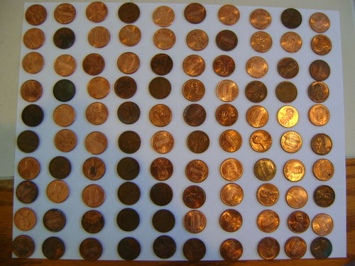
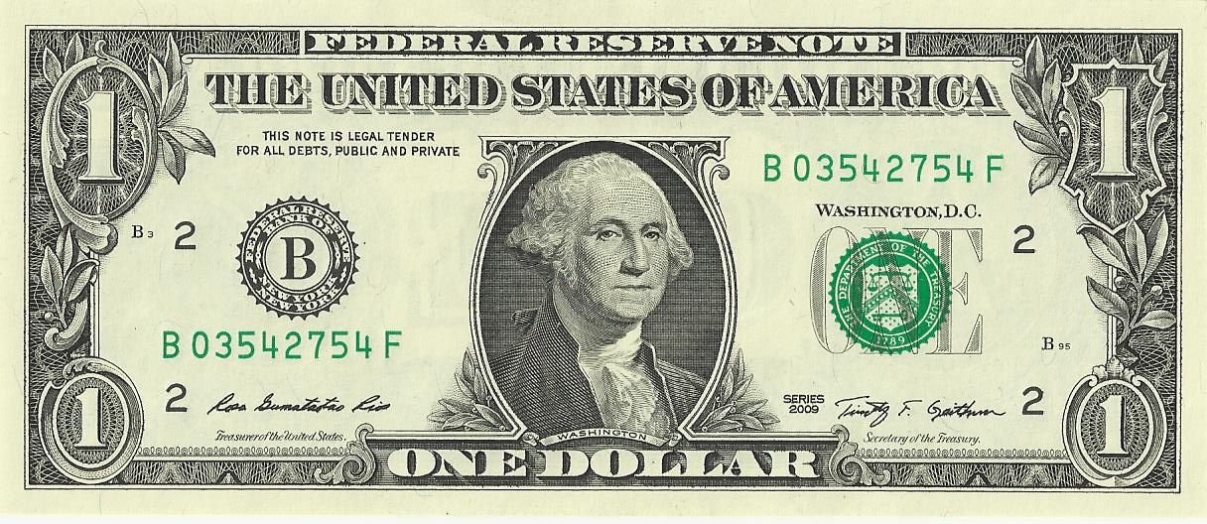
Notes
For example: 100 pennies = 1 dollar
This conversion factor works because it represents the same amount of money.

Slide 13
Notes
We can also write a conversion factor as a fraction.
For example:
100 dimes
1 dollar

Slide 14
Practice
Same amount of money 10 dimes = 1 dollar 10 dimes/1 dollar
2. Same amount of time
365 days = 1 year
365 days/1 year

Slide 15
Practice
3. Same length
1 foot = 12 inches
1 foot/12 inches
4. Same length
1 yard = 3 feet
1 yard/3 feet

Slide 16
Practice
5. Same amount of time
60 seconds = 1 minutes
60 seconds/1 minute
6. Same amount of time
24 hours = 1 day
24 hours/1 day

Slide 17
Notes
We can use a structure called a t –chart to help us convert units using the correct conversion factors.
using

Slide 18
Notes
To Set up the t-chart:
Underline your givens, circle your desired.
Write the given in the first box and desired units at the end.
Write in the conversion factor so the given units will cancel and only desired units are left.

Slide 19
Example
How many days are in 32 weeks?
Given:
32 weeks
Conversion Factor:
7 days
32 weeks
7 days = 1 week
1 week
days

Slide 20
Notes
Solving the T-Chart
If the numbers are across from each other, then multiply.
If the numbers are on top of each other, divide.
Cancel out units and write the remaining unit with the answer.

Slide 21
Example
How many days are in 32 weeks?
Given:
32 weeks
Conversion Factor:
7 days
32 weeks
✕
÷
7 days = 1 week
1 week
days
224
days

Slide 22
Practice

