Slide 1
Monday, January 12th, 2014
HW: Week 17 Agenda Problems #13 and 14 (from last week)
Objective: We will understand how draw ionic compounds and write their formulae
Catalyst: (make your own chart in your notebook)
Determine the formula if the following atoms created ionic compounds:
Magnesium and Oxygen
Potassium and Sulfur
Calcium and Phosphorous
Classroom expectations:
Wear Kenwood ID.
Cell phones, music players, and headphones are put away.
Food is disposed of or put away.
Dressed appropriately.
Notebook is out and you are ready for today’s class.
***Table of Contents
1/12 Week 18 Catalyst Chart 97
1/12 Week 18 Agenda Problems (Problems Only) 98
1/12 Notes: Drawing Ionic Compounds w/Polyatomic Ions 99

Slide 2
Monday, January 12th, 2014
HW: Week 17 Agenda Problems #13 (from last week)
Objective: We will understand how draw ionic compounds and write their formulae
Catalyst: (make your own chart in your notebook)
Determine the formula if the following atoms created ionic compounds:
Magnesium and Oxygen
Potassium and Sulfur
Calcium and Phosphorous
Classroom expectations:
Wear Kenwood ID.
Cell phones, music players, and headphones are put away.
Food is disposed of or put away.
Dressed appropriately.
Notebook is out and you are ready for today’s class.
***Table of Contents
1/12 Week 18 Catalyst Chart 91
1/12 Week 18 Agenda Problems (Problems Only) 92
1/12 Notes: Drawing Ionic Compounds w/Polyatomic Ions 93

Slide 3
Announcements
Tutoring this week: TODAY and TOMORROW
Missed Unit 4 Exam? Must make up TODAY or TOMORROW after school. NO MORE EXTENDED TIME WILL BE GIVEN
Due to printer issues Week 18 Agenda MUST BE FOUND ONLINE ☹….sorry for the inconvenience
Week 18 problems won’t be assigned until Tuesday

Slide 4
Semester Exams
9 days left!!!

Slide 5
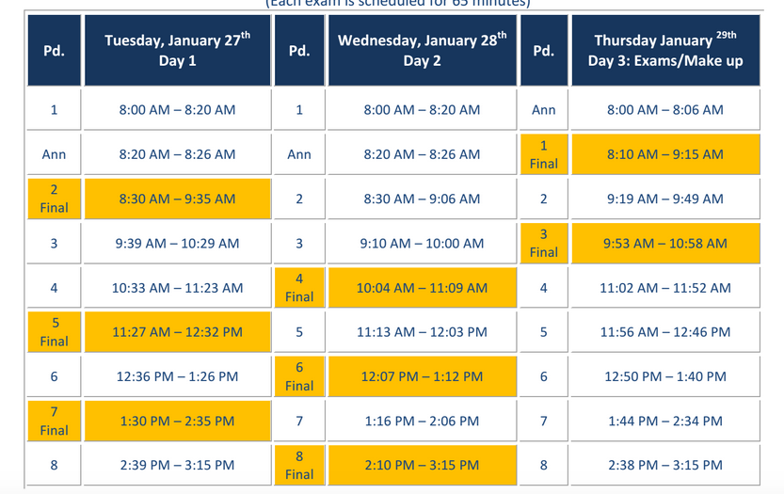
Exam Schedule

Slide 6
Agenda
Catalyst/Announcements
Homework Check
Notes: Drawing Ionic Compounds

Slide 7
Agenda Problems
11a) KS
11b) Na₂O
11c) CaO
11d) Al₂O₃
12) a. Li₂S
c. Al₂O₃
e. KI
13) a. CaF₂
b. AlBr₃
c. Li₂O
d. Al₂S₃

Slide 8
Drawing Ionic Compounds
99

Slide 9
Drawing Ionic Compounds
93

Slide 10
Reminders on IONIC COMPOUND
An IONIC compound consist of a cation (metal) bonded with an anion (non-metal)
An IONIC bond results from a TRANSFER of electrons.

Slide 11
Rules for Drawing Lewis Dot Structures for Ionic Compounds
The cation has NO dots around the symbol and the anion has 8 dots around the symbol.

Slide 12
Rules for Drawing Lewis Dot Structures for Ionic Compounds
If the compound has ONLY one cation and one anion the cation ALWAYS goes first. Brackets go around the anion to show possession of electrons.
Ex: NaCl is ALWAYS drawn as
Na⁺ Cl ⁻

Slide 13
Rules for Drawing Lewis Dot Structures for Ionic Compounds
If the compound has MORE than 2 atoms, draw the structure so it looks even.
Ex: Al₂O₃ = O ²⁻Al³⁺ O ²⁻Al³⁺ O ²⁻
*If you were able to cut the structure in half, you should be holding the same piece in both hands!!!

Slide 14
Rules for Drawing Lewis Dot Structures for Ionic Compounds
The cation must lose ALL of their valence electrons and the anion must have 8 to obey the Octet Rule.

Slide 15
Rules for Drawing Lewis Dot Structures for Ionic Compounds
Each cation should touch each anion it donates electrons to.
Therefore: Two cations should never touch and two anions should never touch.

Slide 16
Whiteboard Practice Problems
No writing on board other than the problem given.
If rule is broken, whiteboard privileges will be REVOKED.

Slide 17
Practice Problem #1
Draw KCl
K⁺ Cl ⁻

Slide 18
Practice Problem #2
Draw MgS
Mg²⁺ S ²⁻

Slide 19
Practice Problem #3
Draw Li₂O
Li⁺ O ²⁻ Li⁺

Slide 20
Practice Problem #4
Draw MgF₂
F ⁻ Mg²⁺ F ⁻

Slide 21
Practice Problem #5
Draw Ga₂S₃
S ²⁻ Ga³⁺ S ²⁻ Ga³⁺ S ²⁻

Slide 22
Practice Problem #6
Draw AlCl₃
Cl ⁻ Al³⁺ Cl ⁻
Cl ⁻

Slide 23
Practice Problem #7
Draw Ca₃N₂
Ca²⁺ N ³⁻ Ca²⁺ N ³⁻ Ca²⁺

Slide 24
Determining Ionic Formulas
Write the symbol for each atom and its charge.
Ex: Calcium + Chlorine
Ca²⁺ Cl⁻

Slide 25
Ionic Formula Determination
2) If the charges are equal, write the formula. If the charges are unequal, add addition atoms to make the charges equal.
Ex: Calcium + Chlorine
Ca²⁺ Cl⁻
Cl⁻

Slide 26
Ionic Formula Determination
2) Write the formula with subscripts to describe the number of each atom required to make a neutral compound.
Ex: Calcium + Chlorine
Ca²⁺ Cl⁻
Cl⁻
CaCl₂
Remember: Switch and DROP the number for the charges.

Slide 27
Example #2
Sodium + Oxygen
Na⁺ O²⁻
Na⁺
Na₂O

Slide 28
Naming Ionic Compounds
When naming ionic compounds:
Name the cation FIRST keeping the name the SAME
Name the anion LAST changing the name to an –ide ending
Ex: Al₂O₃ = Aluminum Oxide

Slide 29
Naming Ionic Compounds
Some of the changes are tricky:
Oxygen = Oxide
Nitrogen = Nitride
Phosphorous = Phosphide
Sulfur = Sulfide

Slide 30
Practice
Name the following compounds:
Na₂S
CaF₂
Mg₂N₂

Slide 31
Exit Ticket
Determine the formula and name for Magnesium + Phosphorous. Then draw the Lewis Dot Structure.

