Slide 1
Tuesday, January 13th, 2014
HW: make sure Week 17 Agenda is COMPLETE
Objective: We will understand how draw ionic compounds and write their formulae
Catalyst: (use new catalyst sheet)
A. At pH 5 only
B. At pH 6.7 only
C. At all pHs between 2 and 11
D. At none of the pHs shown in the figure
Classroom expectations:
Wear Kenwood ID.
Cell phones, music players, and headphones are put away.
Food is disposed of or put away.
Dressed appropriately.
Notebook is out and you are ready for today’s class.
***Table of Contents
1/12 Week 18 Catalyst Chart 91
1/12 Week 18 Agenda Problems (Problems Only) 92
1/12 Notes: Drawing Ionic Compounds 93
1/13 Classwork: Ionic Compounds Practice 94

Slide 2
Announcements
Tutoring this week: TODAY is last day
Missed Unit 4 Exam? Must make up TODAY. NO MORE EXTENDED TIME WILL BE GIVEN

Slide 3
Semester Exams
8 days left!!!

Slide 4
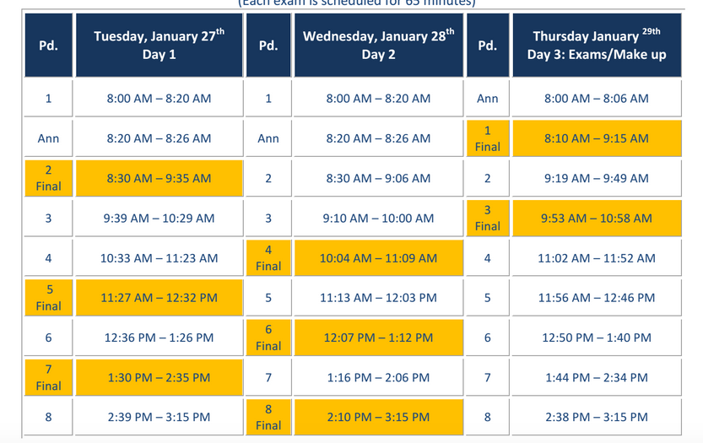
Exam Schedule

Slide 5
Agenda
Catalyst/Announcements
Homework Check
Notes: Drawing Ionic Compounds (cont)

Slide 6
Agenda Problems
11a) KS
11b) Na₂O
11c) CaO
11d) Al₂O₃
12) a. Li₂S
c. Al₂O₃
e. KI
13) a. CaF₂
b. AlBr₃
c. Li₂O
d. Al₂S₃

Slide 7
Drawing Ionic Compounds
93

Slide 8
Practice Problem #3
Draw Li₂O
Li⁺ O ²⁻ Li⁺

Slide 9
Practice Problem #4
Draw MgF₂
F ⁻ Mg²⁺ F ⁻

Slide 10
Practice Problem #5
Draw Ga₂S₃
S ²⁻ Ga³⁺ S ²⁻ Ga³⁺ S ²⁻

Slide 11
Practice Problem #6
Draw AlCl₃
Cl ⁻ Al³⁺ Cl ⁻
Cl ⁻

Slide 12
Practice Problem #7
Draw Ca₃N₂
Ca²⁺ N ³⁻ Ca²⁺ N ³⁻ Ca²⁺

Slide 13
Practice Problem #6
Draw Li₃N
Li+ N ³⁻Li⁺
Li⁺

Slide 14
Determining Ionic Formulas
Write the symbol for each atom and its charge.
Ex: Calcium + Chlorine
Ca²⁺ Cl⁻

Slide 15
Ionic Formula Determination
2) If the charges are equal, write the formula. If the charges are unequal, add additional atoms to make the charges equal.
Ex: Calcium + Chlorine
Ca²⁺ Cl⁻
Cl⁻

Slide 16
Ionic Formula Determination
2) Write the formula with subscripts to describe the number of each atom required to make a neutral compound.
Ex: Calcium + Chlorine
Ca²⁺ Cl⁻
Cl⁻
CaCl₂

Slide 17
Example #2
Sodium + Oxygen
Na⁺ O²⁻
Na⁺
Na₂O

Slide 18
Naming Ionic Compounds
When naming ionic compounds:
Name the cation FIRST keeping the name the SAME
Name the anion LAST changing the name to an –ide ending
Ex: Al₂O₃ = Aluminum Oxide

Slide 19
Naming Ionic Compounds
Some of the changes are tricky:
Oxygen = Oxide
Nitrogen = Nitride
Phosphorous = Phosphide
Sulfur = Sulfide

Slide 20
Practice
Name the following compounds:
Na₂S
CaF₂
Mg₂N₂

Slide 21
Practice Worksheet
Work on the worksheet for the duration of class. The work you complete COULD replace a missing grade IF you stay on task.

