Slide 1
Tuesday, January 13th, 2015
Classroom expectations:
Wear Kenwood ID.
Cell phones, music players, and headphones are put away.
Food is disposed of or put away.
Dressed appropriately.
Notebook is out and you are ready for today’s class.
HW: Week 18 Agenda Problems #2-4
Objective: We will understand how draw ionic compounds w/transition metals and write their formulae.
Catalyst: (use the new catalyst sheet)
F. 34°C.
G. 42°C.
H. 50°C.
J. 62°C.
***Table of Contents
1/12 Week 18 Catalyst Chart 97
1/12 Week 18 Agenda Problems 98
1/12 Notes: Drawing Ionic Compounds 99
1/13 Periodic Table 100
1/13 Notes: Drawing Ionic Compounds w/Transition Metals 101

Slide 2
Announcements
Tutoring this week: TODAY is last day
Missed Unit 4 Exam? Must make up TODAY. NO MORE EXTENDED TIME WILL BE GIVEN

Slide 3
Semester Exams
8 days left!!!

Slide 4
Exam Schedule

Slide 5
Agenda
Catalyst/Announcements
Exit Ticket Review
Homework Check
Notes: Drawing Ionic Compounds w/Transition Metals

Slide 6
Exit Ticket
Determine the name and formula for Magnesium + Phosphorous and then draw the Lewis Dot Structure for the compound.

Slide 7
Agenda Problems
11a) KS
11b) Na₂O
11c) CaO
11d) Al₂O₃
12) a. Li₂S
c. Al₂O₃
e. KI
13) a. CaF₂
b. AlBr₃
c. Li₂O
d. Al₂S₃
14)

Slide 8
Ionic Compounds with Transition Metals
101

Slide 9
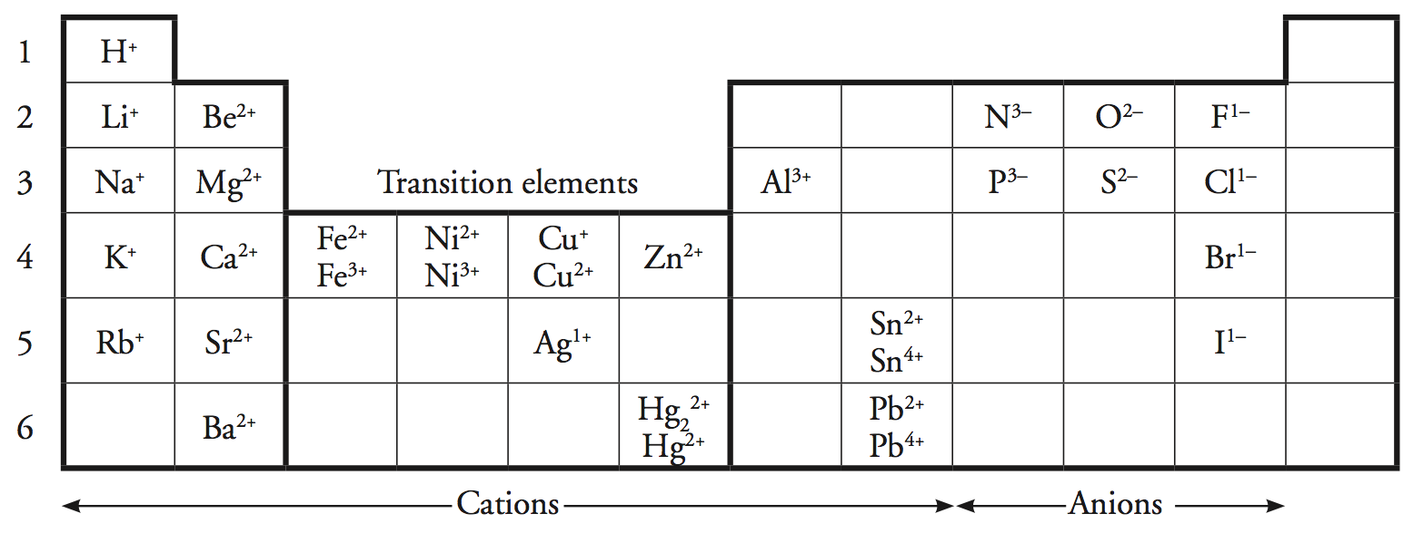
Transition Metals
1.) Consider the ions potassium (K) and sulfur (S). Write chemical
formulas for all possible ionic compounds these two ions, using the simplest ratios of potassium (K) and sulfur (S). (reduce if needed)

Slide 10
Transition Metals
2.) Consider the ions iron (Fe) and sulfur (S). Write chemical
formulas for all possible ionic compounds for these tow ions, using the simplest ratios of iron (Fe) and sulfur (S).

Slide 11
Transition Metals
2.) Using what you know about naming ionic compounds name:
a.) K₂S
b.) FeS
c.) Fe₂S₃
Notice anything in the names that could lead to some confusion??

Slide 12
Naming Ionic Compounds with Transition Metals
1.) When a metal can form multiple cations, the charge must be indicated in the name by a roman numeral.
For example:
Fe²⁺ = Iron (II) ion
Fe³⁺ = Iron (III) ion

Slide 13
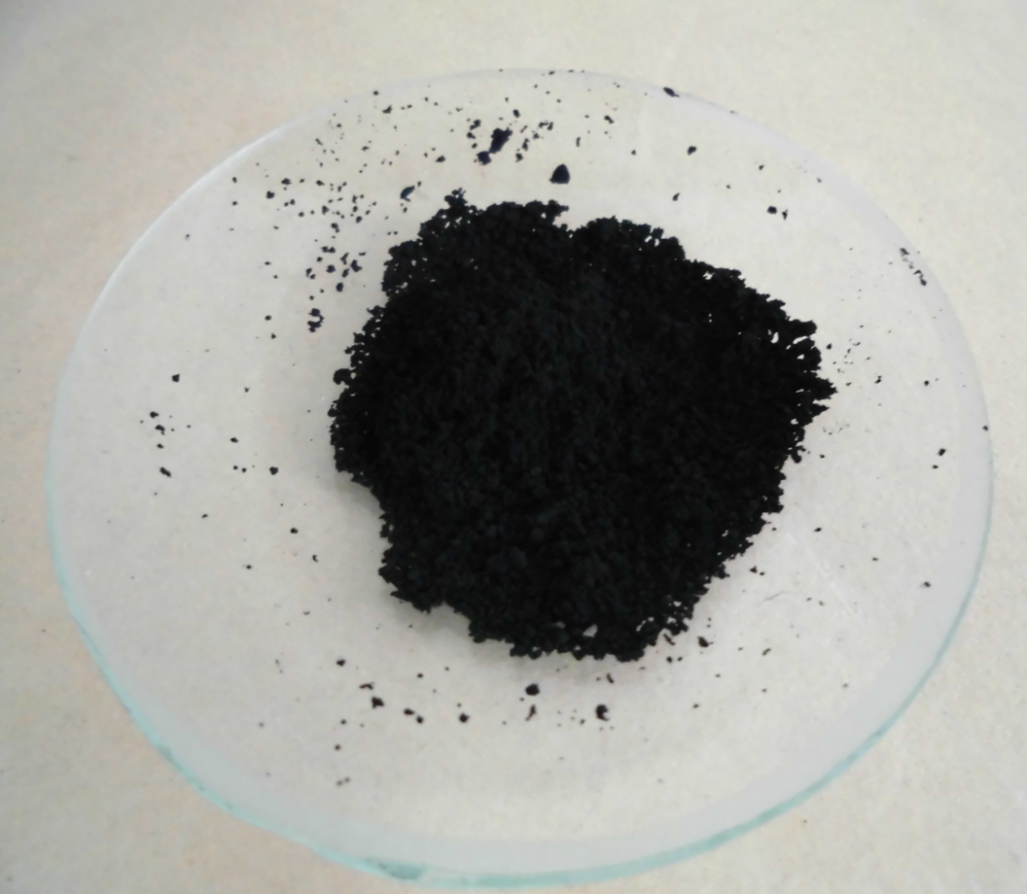
Naming Ionic Compounds with Transition Metals
2.) Write a list of your ions and write in the charges of the anion(s).
For example:
PbO₂
PbO₂
Pb? O²⁻
O²⁻

Slide 14
Naming Ionic Compounds with Transition Metals
3.) Add up the charges of the anions and determine the charge of the type II metal.
For example:
PbO₂
PbO₂
Pb? O²⁻
O²⁻
+____
+____
+4
-4
Pb needs a charge of +4 to cancel out the -4 charges.

Slide 15
Naming Ionic Compounds with Transition Metals
4.) Name the compound by including roman numerals to denote the charge.
For example:
PbO₂ = lead (IV) oxide

Slide 16
Example #2
What is the name of Ti₃N₂?
Ti ? N³⁻
Ti ? N³⁻
Ti ?
+___________________
-6
All of the titanium ions need a total charge of +6

Slide 17
Example #2
What is the name of Ti₃N₂?
Ti ? N³⁻
Ti ? N³⁻
Ti ?
+___________________
+6
-6
6 ÷ 3 = 2

Slide 18
Example #2
What is the name of Ti₃N₂?
Ni ? N³⁻
Ni ? N³⁻
Ni ?
+___________________
+6
-6
Each individual titanium ion has a +2 charge
6 ÷ 3 = 2

Slide 19
Example #2
What is the name of Ti₃N₂?
Ni ? N³⁻
Ni ? N³⁻
Ni ?
+___________________
+6
-6
6 ÷ 3 = 2
Ti₃N₂ = titanium (II) nitride

Slide 20
Whiteboard Practice
What is the charge on the cation of copper (I) sulfide.
+1

Slide 21
Whiteboard Practice
What is the charge on the cation of copper (II) oxide.
+2

Slide 22
Whiteboard Practice
Write the compound name of CuO.
Copper (II) Oxide

Slide 23
Whiteboard Practice
Write the compound name of PbCl₂.
Lead (II) Chloride

Slide 24
Whiteboard Practice
Write the compound name of PbS₂.
Lead (IV) Sulfide

Slide 25
Writing Chemical Formulae for ionic compounds with type II metals
1.) Write the cation and anion with their charges.
For example: Iron (III) chloride
Fe³⁺ Cl¹⁻

Slide 26
Writing Chemical Formulae for ionic compounds with type II metals
2.) Add cations and anions until the charges equal zero.
For example: Iron (III) chloride
Fe³⁺ Cl¹⁻
Cl¹⁻
Cl¹⁻

Slide 27
Writing Chemical Formulae for ionic compounds with type II metals
3.) Total the number of cations and anions to determine the subscripts in the formula.
For example: Iron (III) chloride
Fe³⁺ Cl¹⁻
Cl¹⁻
Cl¹⁻
Iron (III) chloride = FeCl₃

Slide 28
Whiteboard Practice
Write the chemical formula of iron (II) chloride.
FeCl₂

Slide 29
Whiteboard Practice
Write the chemical formula of chromium (III) oxide.
Cr₂O₃

Slide 30
Whiteboard Practice
Write the chemical formula of tin (II) oxide.
SnO

Slide 31
Whiteboard Practice
Write the chemical formula of tin (IV) oxide.
SnO₂

Slide 32
Whiteboard Practice
What information is told by the roman numeral in the name of an ionic compound?
The charge on an atom that has the potential to form multiple ions.

