Slide 1
Door
Front Table
Door
Dajionae
Jerimiah
Kamyl
Coumba
Zlandria
Christian
Quinetta
Lorenzo
Ladjion
Mame
Jazmine
Emmanuel
Rajah
Rashad
Ronald
Brianna
Mariah
Cemarah
Alyssa
Jakobi
Maleena
Manny
Yah
Breona
Jeremy
Naimah
Kai
Janea
X
X
X
Notes:
CB Chem Period 2

Slide 2
Door
Front Table
Door
Jacob
Kensington
Derek
Juwan
Samiyah
Anubia
Amiyah
Gabe
Kennedy
Tril
Jared
Kevin
Alexandria
Malcolm
Martez
Xavier
Marieal
Kendra
Monee
Caira
Cheyenne
Clarissa
Tionna
Bonito
Kyle
X
X
X
Notes:
CB Chem Period 7

Slide 3
Door
Front Table
Door
Tiffany
Shanelle
Alisia
Jade
Armani
Siniah
Keyshawn
Rayshon
Calvin
Curtis
Remi
Cairo
Amber
Koby
Dwight
Dre
Tia
Imani
Arryl
Unique
Nailah
X
X
X
Notes:
CB Chem Period 8

Slide 4
Monday, April 27, 2015
Classroom expectations:
Wear Kenwood ID.
Cell phones, music players, and headphones are put away.
Food is disposed of or put away.
Dressed appropriately.
Notebook is out and you are ready for today’s class.
HW =
Objective: SWBAT determine how dilutions change the pH of solutions.
Standard: IOD 303
Catalyst:
a. 0.100 L
b. 0.500 L
c. 1.000 L
d. 10.000 L
Table of Contents:
7 4/26 Week 32 Catalyst 38
7 4/26 Notes: Dilution 39
Notes:
a

Slide 5
Announcements
Tutoring Wednesday after school
Quiz Thursday!

Slide 6
Agenda
Catalyst
Announcements
Dilution Notes
Exit Ticket

Slide 7
How can pH be changed?
On your notes sheet, predict some ways that the pH of a solution could be changed. EXPLAIN your reasoning!

Slide 8
Molarity
Molarity is a measure of the concentration of a solute per liter of a solution.
Unit “M”
A substance with more solute particles per volume of solvent, or greater molarity, is more concentrated.
A substance with less solute particles per volume of solvent, or lesser molarity, is more dilute.

Slide 9
Dilution
Because water is neutral, it can be used to make a substance less concentrated.
Dilution: the process of adding water to a solution resulting in a lower concentration.

Slide 10
How Dilution Works

Slide 11
How can diluting a solution change the pH?
When adding water to an acid, the pH will increase until it reaches 7, then it will not increase past 7.
When adding water to a base, the pH will decrease until it reaches 7, then it will not decrease past 7.

Slide 12
How much water should we add to neutralize a solution?
Let’s say we had a solution of 2M HCl. How much of the 2M solution should we add to make 50 mL of a 1M solution?

Slide 13
.
We know three things:
Molarity of the original solution: 2M
Volume of the desired solution: 50 mL
Molarity of the desired solution: 1M
What we need is the volume of the original solution to add!

Slide 14
Dilution Equation
We can use the dilution equation:
m₁v₁ = m₂v₂
Where:
m₁ = molarity of the concentrated solution to add
v₁ = volume of the concentrated solution to add
m₂ = molarity of desired solution
v₂ = volume of desired solution

Slide 15
Dilution Equation
In our example:
m₁v₁ = m₂v₂
m₁ = 2 M
v₁ = ?
m₂ = 1 M
v₂ = 50 mL
So:
(2M) x ? = (1M) x 50mL
(2M)v₁ = 1M x 50 mL
(2M)v₁ = 50 M*mL
50 M*mL
v₁ = = 25 mL
2M

Slide 16
Dilution Equation
THIS MEANS:
We would need to add 25 mL of the original 2M solution, and 25 mL of water, to create the solution we want!
So:
(2M) x ? = (1M) x 50mL
(2M)v₁ = 1M x 50 mL
(2M)v₁ = 50 M*mL
50 M*mL
v₁ = = 25 mL
2M

Slide 17
Practice
Work on the practice problems on your notes sheet.

Slide 18
Exit Ticket
You have a 12M solution of HCl, and want to make a 50 mL solution of 3M HCl. How much of the 12M solution should you add to make the 3M solution you want?

Slide 19
Door
Front Table
Door
Dajionae
Jerimiah
Kamyl
Coumba
Zlandria
Christian
Quinetta
Lorenzo
Ladjion
Mame
Jazmine
Emmanuel
Rajah
Rashad
Ronald
Brianna
Mariah
Cemarah
Alyssa
Jakobi
Maleena
Manny
Yah
Breona
Jeremy
Naimah
Kai
Janea
X
X
X
Notes:
CB Chem Period 2

Slide 20
Door
Front Table
Door
Jacob
Kensington
Derek
Juwan
Samiyah
Anubia
Amiyah
Gabe
Kennedy
Tril
Jared
Kevin
Alexandria
Malcolm
Martez
Xavier
Marieal
Kendra
Monee
Caira
Cheyenne
Clarissa
Tionna
Bonito
Kyle
X
X
X
Notes:
CB Chem Period 7

Slide 21
Door
Front Table
Door
Tiffany
Shanelle
Alisia
Jade
Armani
Siniah
Keyshawn
Rayshon
Calvin
Curtis
Remi
Cairo
Amber
Koby
Dwight
Dre
Tia
Imani
Arryl
Unique
Nailah
X
X
X
Notes:
CB Chem Period 8

Slide 22
Tuesday, April 28, 2015
Classroom expectations:
Wear Kenwood ID.
Cell phones, music players, and headphones are put away.
Food is disposed of or put away.
Dressed appropriately.
Notebook is out and you are ready for today’s class.
HW =
Objective: SWBAT perform a dilution series and compare the concentration and pH of each solution.
Standard: IOD 303
Catalyst:
a. Molarity
b. Mass
c. Mole fraction
d. Molar Mass
Table of Contents:
7 4/28 Lab: Molarity of Lemonade 40
Notes:
a

Slide 23
Announcements
Tutoring tomorrow after school
Quiz Thursday!

Slide 24
Agenda
Catalyst
Announcements
Dilution mini-lab
Exit Ticket

Slide 25
Exit Ticket
You have a 12M solution of HCl, and want to make a 50 mL solution of 3M HCl. How much of the 12M solution should you add to make the 3M solution you want?
How well did each of your group members contribute to the lab?

Slide 26
Wednesday, April 29th, 2015
HW=
Objective: SWBAT explain how concentration of H₃O⁺ can be used to calculate pH.
Standard: IOD 303
Catalyst:
a. 5.55
b. 10
c. 1,000
d. 6.02 x 10²³
Classroom expectations:
Wear Kenwood ID.
Cell phones, music players, and headphones are put away.
Food is disposed of or put away.
Dressed appropriately.
Notebook is out and you are ready for today’s class.
Table of Contents:
7 4/29 Notes: The pH Concept 41
Notes:
d

Slide 27
Announcements
Tutoring Today!
Quiz tomorrow!

Slide 28
Agenda
Catalyst/Announcements
The pH Concept Notes
Exit Ticket

Slide 29
Review
Please complete the review problems at the top of your worksheet.

Slide 30
Looking Back
Look back to your “Investigating Acids & Bases” sheet in your binder.

Slide 31
Molarity
The concentration of a solution is a measure of the amount of the solute that is dissolved in a given quantity of solvent.

Slide 32
Molarity
Solvent: substance that is present in the greatest amount in a solution.

Slide 33
Molarity
Solute: substance that is present in a smaller amount than the solvent in a solution.

Slide 34
Molarity
M = Molarity
When the symbol “M” is accompanied by a number it is read as “molar”.
Example: 3M = three molar

Slide 35
Molarity
Square brackets [] around a substance indicate molar concentration.
Example: [H⁺] = molar concentration of hydronium ions

Slide 36
Molarity
moles of solute
liters solvent
Molarity=

Slide 37
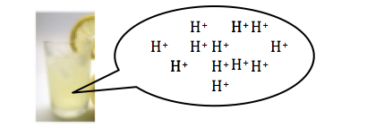
Example #1
What is the molarity if you have 0.0025 moles of H⁺ and 5.0 liters of solution?
0.0025 moles
5.0 liters
M =
M = 5.0 x 10⁻⁴

Slide 38
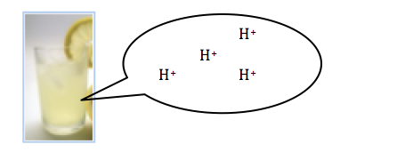
Example #2
Calculate the hydronium ion concentration if you have 0.00025 moles of H⁺ and 50,000.0 liters of solution?
[H⁺] =
0.00025 moles
50,000.0 liters
[H⁺] = 5 x 10⁻⁸ M

Slide 39
pH
The pH of a solution is a measure of how acidic or basic a substance using [H⁺] or [H₃0⁺]. The smaller the pH number the greater the concentration of [H⁺] or [H₃0⁺]!

Slide 40
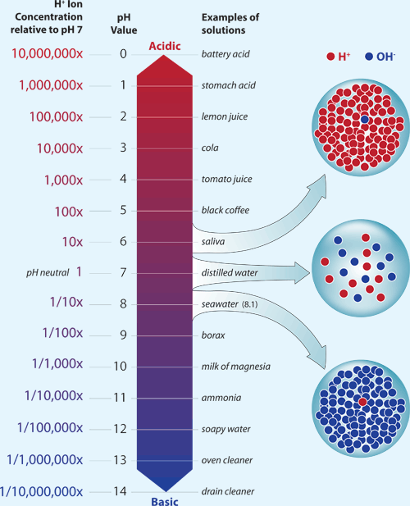

Slide 41
pH
pH = -log[H⁺]

Slide 42
pH
What is the pH of the lemonade solution in example 1?
pH = -log(5.0 x 10⁻⁴ M)
pH = 3.3

Slide 43
pH
What is the pH of the lemonade solution in example 2?
pH = -log(5 x 10⁻⁸ M)
pH = 7.3

Slide 44
pH Scale
Neutral
Strong acid
Weak Acid
Weak Base
Strong Base
pH
1
2
3
4
5
6
7
8
9
10
11
12
13
14
1x10⁻¹
1x10⁻³
1x10⁻⁵
1x10⁻⁷
1x10⁻⁹
1x10⁻¹¹
1x10⁻¹³
Hydronium Ion Concentration [H⁺]

Slide 45
Practice
Please complete the practice problems on the bottom of your notes sheet.

Slide 46
Exit Ticket
***NOTE: At least set up the problems, if you don’t have a calculator!!***
Calculate the hydronium concentration, [H₃0⁺], of a lemonade’s solution if there is:
> 2.5 moles in 13 Liters
> 0.0058 moles in 150 Liters
What will the pH of both of the above solutions be?
How confident are you in the material we talked about today?

Slide 47
Exit Ticket
***NOTE: At least set up the problems, if you don’t have a calculator!!***
Calculate the hydronium concentration, [H₃0⁺], of a lemonade’s solution if there is:
> 2.5 moles in 13 Liters
> 0.0058 moles in 150 Liters
What will the pH of both of the above solutions be?
How confident are you in the material we talked about today?

Slide 48
Thursday, April 30th, 2015
HW=
Objective: SWBAT explain how concentration of H₃O⁺ can be used to calculate pH.
Standard: IOD 303
Catalyst:
a. Molarity
b. Mass concentration
c. Mole fraction
d. All of the above are expressions of the proportion of solute to solvent in a solution.
Classroom expectations:
Wear Kenwood ID.
Cell phones, music players, and headphones are put away.
Food is disposed of or put away.
Dressed appropriately.
Notebook is out and you are ready for today’s class.
Table of Contents:
7 4/30 Classwork: The pH Concept part 2 42
Notes:
d

Slide 49
Announcements
Quiz TODAY!

Slide 50
Agenda
Catalyst/Announcements
QUIZ!
pH + [H₃O⁺] Calculation Practice
Exit Ticket

Slide 51
pH Scale
Neutral
Strong acid
Weak Acid
Weak Base
Strong Base
pH
1
2
3
4
5
6
7
8
9
10
11
12
13
14
1x10⁻¹
1x10⁻³
1x10⁻⁵
1x10⁻⁷
1x10⁻⁹
1x10⁻¹¹
1x10⁻¹³
Hydronium Ion Concentration [H⁺]

Slide 52
Calculating [H₃O⁺] from pH
To calculate the hydronium ion concentration [H₃O⁺] from pH, we must “reverse” the log.
[H₃O⁺] = 10^{-pH}

Slide 53
Exit Ticket
How are pH and [H₃O⁺] related?
Set up and solve the calculation for:
[H₃O⁺] if pH = 7.4
pH if [H₃O⁺] = 8.3 x 10⁻⁹ M
How confident are you in these calculations?

