Slide 1
Door
Front Table
Door
Dajionae
Jerimiah
Kamyl
Coumba
Zlandria
Christian
Quinetta
Lorenzo
Ladjion
Mame
Jazmine
Emmanuel
Rajah
Rashad
Ronald
Brianna
Mariah
Cemarah
Alyssa
Jakobi
Maleena
Manny
Yah
Breona
Jeremy
Naimah
Kai
Janea
X
X
X
Notes:
CB Chem Period 2

Slide 2
Door
Front Table
Door
Jacob
Kensington
Derek
Juwan
Samiyah
Anubia
Amiyah
Gabe
Kennedy
Tril
Jared
Kevin
Alexandria
Malcolm
Martez
Xavier
Marieal
Kendra
Monee
Caira
Cheyenne
Clarissa
Tionna
Bonito
Kyle
X
X
X
Notes:
CB Chem Period 7

Slide 3
Door
Front Table
Door
Tiffany
Shanelle
Alisia
Jade
Armani
Siniah
Keyshawn
Rayshon
Calvin
Curtis
Remi
Cairo
Amber
Koby
Dwight
Dre
Tia
Imani
Arryl
Unique
Nailah
X
X
X
Notes:
CB Chem Period 8

Slide 4
Monday, May 4th, 2015
Classroom expectations:
Wear Kenwood ID.
Cell phones, music players, and headphones are put away.
Food is disposed of or put away.
Dressed appropriately.
Notebook is out and you are ready for today’s class.
HW =
Objective: SWBAT calculate pH from hydronium ion concentration and vice versa.
Standard: IOD 303
Catalyst:
a. 0.01 AU
b. 0.02 AU
c. 0.99 AU
d. 1.01 AU
Table of Contents:
4/30 Classwork: The pH Concept part 2 42
7 5/4 Week 33 Catalyst 43
7 5/4 Classwork: Strong Acids vs. Weak Acids 44
Notes:
a

Slide 5
Announcements
Tutoring Tuesday after school
Binder quiz on FRIDAY

Slide 6
Missing Quizzes!
2nd Period:
Kamyl Bailey
Naimah Jackson
Dajionae Jones
Jeremiah Martin
Coumba Soumare
Rashad Thomasbland
7th Period:
Martez El
Marieal Helm
Joseph Mensah
Kennedy Taylor
8th Period
Amber Haynes
Dwight Forest

Slide 7
Agenda
Catalyst
Announcements
[H₃O⁺] calculation practice
Strong Acids vs. Weak Acids Activity
Exit Ticket

Slide 8
Calculating [H₃O⁺] from pH
To calculate the hydronium ion concentration [H₃O⁺] from pH, we must “reverse” the log.
[H₃O⁺] = 10^{-pH}

Slide 9
Exit Ticket
Calculate the [H₃O⁺] for a solution with a pH of:
7.2
2.9
Calculate the pH of a solution with a [H₃O⁺] of:
0.000082.
2.4 x 10⁻⁶
How confident are you about pH and [H₃O⁺] calculations?

Slide 10
Tuesday, May 5th, 2015
Classroom expectations:
Wear Kenwood ID.
Cell phones, music players, and headphones are put away.
Food is disposed of or put away.
Dressed appropriately.
Notebook is out and you are ready for today’s class.
HW =
Objective: SWBAT calculate pH from hydronium ion concentration and vice versa.
Standard: IOD 303
Catalyst:
a. 0⁰
b. 60⁰
c. 120⁰
d. 180⁰
Table of Contents:
7 5/4 Week 33 Catalyst 43
7 5/4 Classwork: Strong Acids vs. Weak Acids 44
Notes:
c

Slide 11
Announcements
Tutoring TODAY after school
SOME OF YOU HAVE MISSING QUIZZES/TESTS THAT YOU MUST MAKE UP OR THEY WILL REMAIN A ZERO!!!
Binder quiz on FRIDAY!
Content quiz next TUESDAY!
Summative Project due next TUESDAY!

Slide 12
Major Grades Coming Up
Unit 7 Summative Project
Carbonic Acid Lab (Questions, no write up)
Titration Lab (Questions, no write up)
Unit 7 Quiz 2
Semester 2 Final
Independent Research Project Work, Write up, and Presentation

Slide 13
Agenda
Catalyst
Announcements
Strong Acids vs. Weak Acids Activity
Exit Ticket

Slide 14
Exit Ticket
Tell me:
3 – things you learned about strong acids and weak acids.
2 – questions you have about strong acids and weak acids.
1 – substance you think is a strong acid, and another substance you think is a weak acid and WHY.

Slide 15
Wednesday, May 6th, 2015
Classroom expectations:
Wear Kenwood ID.
Cell phones, music players, and headphones are put away.
Food is disposed of or put away.
Dressed appropriately.
Notebook is out and you are ready for today’s class.
HW =
Objective: SWBAT differentiate between weak and strong acids.
Standard: IOD 303
Catalyst:
a. Earth, Mars, Mercury, Venus
b. Mars, Earth, Venus, Mercury
c. Mercury, Venus, Mars, Earth
d. Mercury, Venus, Earth, Mars
Table of Contents:
7 5/6 Lab: Formation of Carbonic Acid 45
Notes:
d

Slide 16
Announcements
Binder quiz on FRIDAY!
Content quiz next TUESDAY!
Summative Project due next TUESDAY!

Slide 17
Agenda
Catalyst
Announcements
Finish Strong Acids vs. Weak Acids Activity
Begin Formation of Carbonic Acid Lab
Exit Ticket

Slide 18
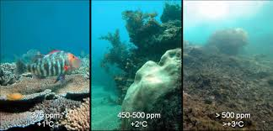
Formation of Carbonic Acid Lab
Paired Reading
Pre-Lab Questions
Video

Slide 19
Exit Ticket
What are two major differences between strong and weak acids?
How has carbon dioxide (CO₂) affected the environment?
List one question you have about carbon dioxide (CO₂) and the environment.

Slide 20
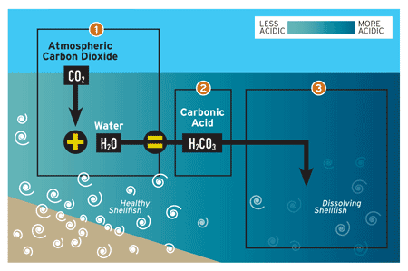

Slide 21
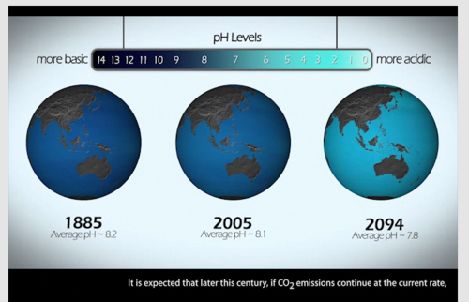

Slide 22
Thursday, May 7th, 2015
Classroom expectations:
Wear Kenwood ID.
Cell phones, music players, and headphones are put away.
Food is disposed of or put away.
Dressed appropriately.
Notebook is out and you are ready for today’s class.
HW =
Objective: SWBAT investigate the formation of carbonic acid and pH change in oceans.
Standard: IOD 303
Catalyst:
a. L1, L3, L2
b. L2, L1, L3
c. L3, L2, L1
d. L2, L3, L1
Table of Contents:
7 5/6 Lab: Formation of Carbonic Acid 45
Notes:
d

Slide 23
Announcements
Binder quiz on TOMORROW!
Content quiz next TUESDAY!
Summative Project due next TUESDAY!

Slide 24
Agenda
Catalyst
Announcements
Formation of Carbonic Acid Lab
Clean up!!
Exit Ticket

Slide 25
Formation of Carbonic Acid Lab
Paired Reading
Pre-Lab Questions
Video

Slide 26
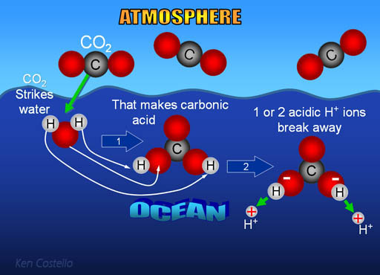

Slide 27
Clean Up Procedure
Rinse out all beakers and graduated cylinders and place them on the top of your lab table.
Throw away straws ONLY (keep the paper cups).
Wipe down you lab table with a Clorox wipe

Slide 28
Exit Ticket
How did the pH of the water change the longer you blew into the water?
Based on what you know about Carbon dioxide, if there is more carbon dioxide in the atmosphere, how will that affect oceans?
Thinking back to yesterday, does molarity affect pH?

Slide 29
Friday, May 8th, 2015
Classroom expectations:
Wear Kenwood ID.
Cell phones, music players, and headphones are put away.
Food is disposed of or put away.
Dressed appropriately.
Notebook is out and you are ready for today’s class.
HW = SUMMATIVE PROJECT!!!
Objective: SWBAT investigate the formation of carbonic acid and pH change in oceans and explain titrations.
Standard: IOD 303
Catalyst:
a. 0.3 years
b. 0.5 years
c. 1.5 years
d. 2.0 years
Table of Contents:
7 5/8 Quick Notes: Titration 46
Notes:
b

Slide 30
Announcements
Binder quiz on TODAY!
Content quiz next TUESDAY!
Summative Project due next TUESDAY!

Slide 31
Agenda
Catalyst
Binder Quiz
Announcements
Finish Lab Questions
Titration Quick Notes
Exit Ticket

Slide 33
Formation of Carbonic Acid Lab
Video

Slide 34
Titration
A neutralization reaction occurs between a strong acid and a strong base produces an ionic salt and water.
How can a neutralization reaction help you figure out acid or base concentration?
We can use m1v1=m2v2 again!

Slide 35
Discussion Notes
The chemical equation for the neutralization reaction shows the ratio in which the substances combine.
HCl(aq) + NaOH(aq) ➔ NaCl(aq) + H₂O(l)

Slide 37
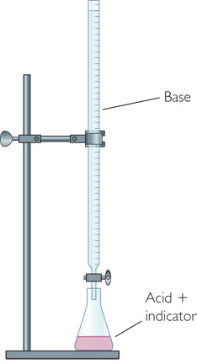
Discussion Notes (cont.)
A titration is a procedure in which a neutralization reaction is monitored with an indicator allowing you to calculate the unknown concentration of an acid or base.
When the equivalence point is reached in a titration between a strong acid and a strong base, the number of moles of H⁺ ions equals the number of moles of OH– ions.

Slide 38
Wrap Up
How can a neutralization reaction help you figure out acid or base concentration?
A titration is a procedure that allows you to calculate the unknown concentration of an acid or a base using a neutralization reaction.
During a titration, an indicator is used to signal when the equivalence point has been reached.

Slide 39
EXIT TICKET
A beaker has 50 drops of HCl, along with a drop of phenolphthalein indicator.
After 100 drops of 0.10 M NaOH are added, the color changes from clear to bright pink. What is the concentration of the original HCl solution?

